Slide 1

Agenda
Kick Off
Cloud Adoption Framework Azure Landing Zones
Terraform module for CAF ALZ
Terraform Basics
Demos and Hands-On Labs
Questions & Answers Sessions
Close Out

Slide 2
Microsoft Cloud Adoption Framework for Azure
Define strategy
Understand motivations
Business outcomes
Business justification
Prioritize project
Plan
Digital estate
Initial organization alignment
Skills readiness plan
Cloud adoption plan
Ready
Azure setup guide
First landing zone
Expand the landing zone
Best practice validation
Ready
Azure setup guide
First landing zone
Expand the landing zone
Best practice validation
Adopt
Migrate First workload migration Expanded scenarios Best practice validation Process improvements
Innovate Innovation guide Expanded scenarios Best practice validation Process improvements
Govern
Methodology
Benchmark initial best practice
Governance maturity
Manage
Business commitments
Operations baseline
Operations maturity
https://aka.ms/adopt/overview
Notes:
The Microsoft Cloud Adoption Framework aligns different phases of the cloud adoption lifecycle to ensure easy access to the right guidance at the right time.
Ready: follows the strategy and planning works. It focusses on preparing cloud environment for the planned changes.
This is a key stage of the journey, as it represents the first technical implementation stage of the adoption.
A strong starting point is crucial for a great outcome, so the core elements of the Ready methodology are key success factors.
Ready is also a jump-off point for several of the other methodologies, which rely on the strong start as fuel for their own success:
Migrate: Migrate and modernize existing workloads on the cloud.
Innovate: Develop new cloud-native or hybrid solutions.
Govern: Govern the environment and workloads to ensure industry standards and regulatory requirements.
Manage: Conduct operations management for cloud and hybrid solutions.
Let’s begin looking at what Azure landing zones are.

Slide 3
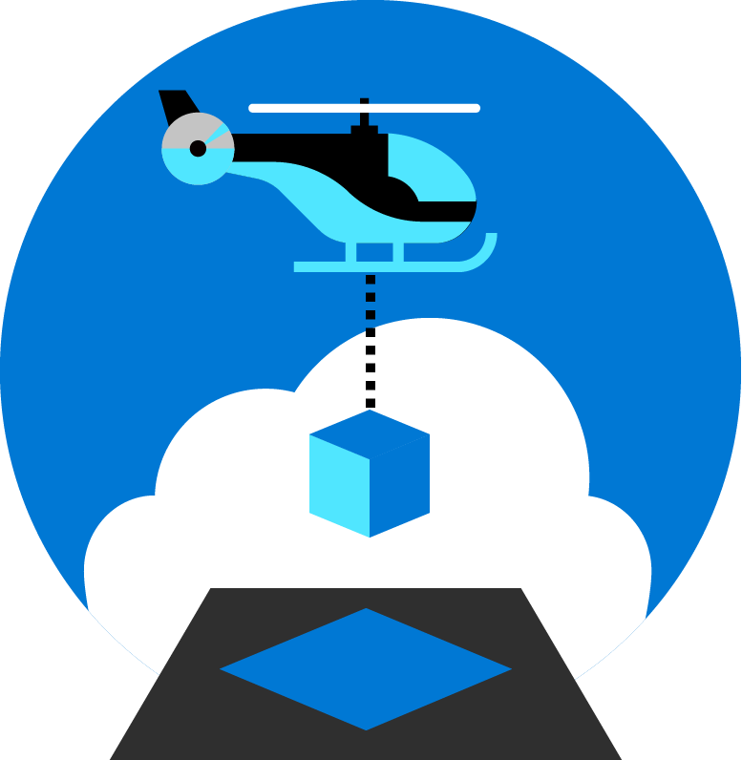
Azure Landing Zones
Notes:
Azure landing zones in the Microsoft Cloud Adoption Framework for Azure are designed to accelerate efforts to map, modernize, or even reimagine the operating model. Azure landing zones help build a cloud environment aligned to the optimal technology operations specific to your needs in the cloud.

Slide 4
What are landing zones for?
Starting a journey based on best practices with a start-to-finish plan is a key factor for success
Creating well-designed foundations for a cloud environment will enable the safe adoption of new technologies, at pace
Using consistent, repeatable environment designs helps scaling out in a manageable way
Baking in repeatable best practices into environment deployments
Factoring your team's technical skills into environment planning
Notes:
A landing zone is intended to help start an environment build from strong foundations.
Best practices
Repeatable to ensure standardization
Consider technical skills of the team and their learning plans as part of the decisions you take in planning your landing zone.
Let's look at the benefits landing zones can provide for your organization.

Slide 5

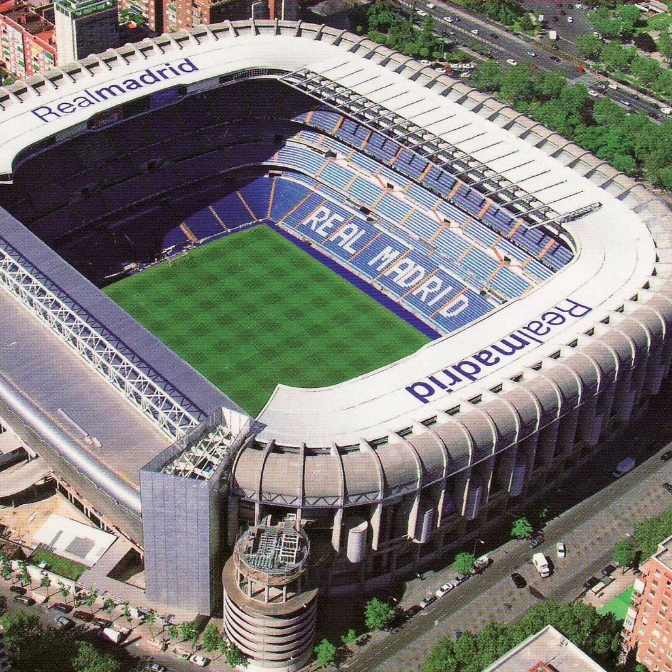

What are you building? Your cloud foundation supports the construction of a…
House
Stadium
Bridge
Notes:
Building a cloud environment like constructing a building—a house, stadium, or bridge.
The structure you’re going to build will determine your approach and architectural style.
Depending on the structure, the foundations may vary.
However, there will be common items across the various foundations.
This is also true in the cloud.
The cloud foundations may vary depending on your requirements, or the scale you need for your environment
but just like construction foundations will start with concrete and steel, cloud environments will also share common starting elements.
Which is where a landing zone comes. Let's look at what purpose they serve.

Slide 6

Metropolis
Using an analogy, this is similar to how city utilities such as water, gas, and electricity are accessible before new houses are constructed.
In this context, the network, IAM, policies, management, and monitoring are shared 'utility' services that must be readily available to support landing zones at scale.
Notes:
TALK TRACK:
One of the best analogies for understanding a landing zone, is to compare it to the necessary services upon which a city is built. Before buildings can be erected and people move into them essentials services must be in place. Road are necessary for people to move around, water and sewer facilities need to be in place, power and gas lines must be made available. You can think of azure landing zones as the essential platform services required for the different types of applications you will host on Azure. Different applications may require different services, and guardrails, and therefore will live in different landing zones. Similar to zoning codes in real life.
One of the major shifts for a centralized IT organization in this scenario is to move from providing all the infrastructure (building for people to live in) to providing the zoning guides (guardrails to be in place for other business units to build their infrastructure and application upon).
One of the main benefit of the cloud is that you can scale resources based on demand and the there is practically no limit on scale. The same applies for scaling down. Just like you turn on light bulbs when you need it and turn it off when you do not , and you are charged only for the portion of electricity when the light bulb is turn on, you can turn on any VM, resources, IOT or any other resources when you need it and turn it off when you do not . Azure give you better option than turn on and off button, imagine a Dial on light bulb and keep adjusting for the light needed indoor during daytime or night when light keep changing because of sunlight or cloud. There is practically no capital cost associated with IT in the cloud because you are not buying hardware to build data center. You are using everything and anything on demand based on need.
Because of this power of unlimited scale, governance problem arises. Due to sheer number of resources, governance and organization of resources become challenge. After all we like to make our and other lives easier, so we think about solving this problem of governance.
I would like you Imagine a library with a pile of books with no marking and sorting and section and you have to find your particular book, it will be difficult, almost impossible.
The same applies to resources in Azure subscription if its not properly organized and not organized for operational efficiency.
Enterprise scale is the answer to organizing subscription to landing zone. We build landing zone so we would know where to go and provision resources when we need them. Just like in a library when we pick up a book , we know where to go to find it or to place it.
Landing zones help with the adoption of cloud and give you a better way of organizing resources not just its type, but by organization, cost and security.

Slide 7
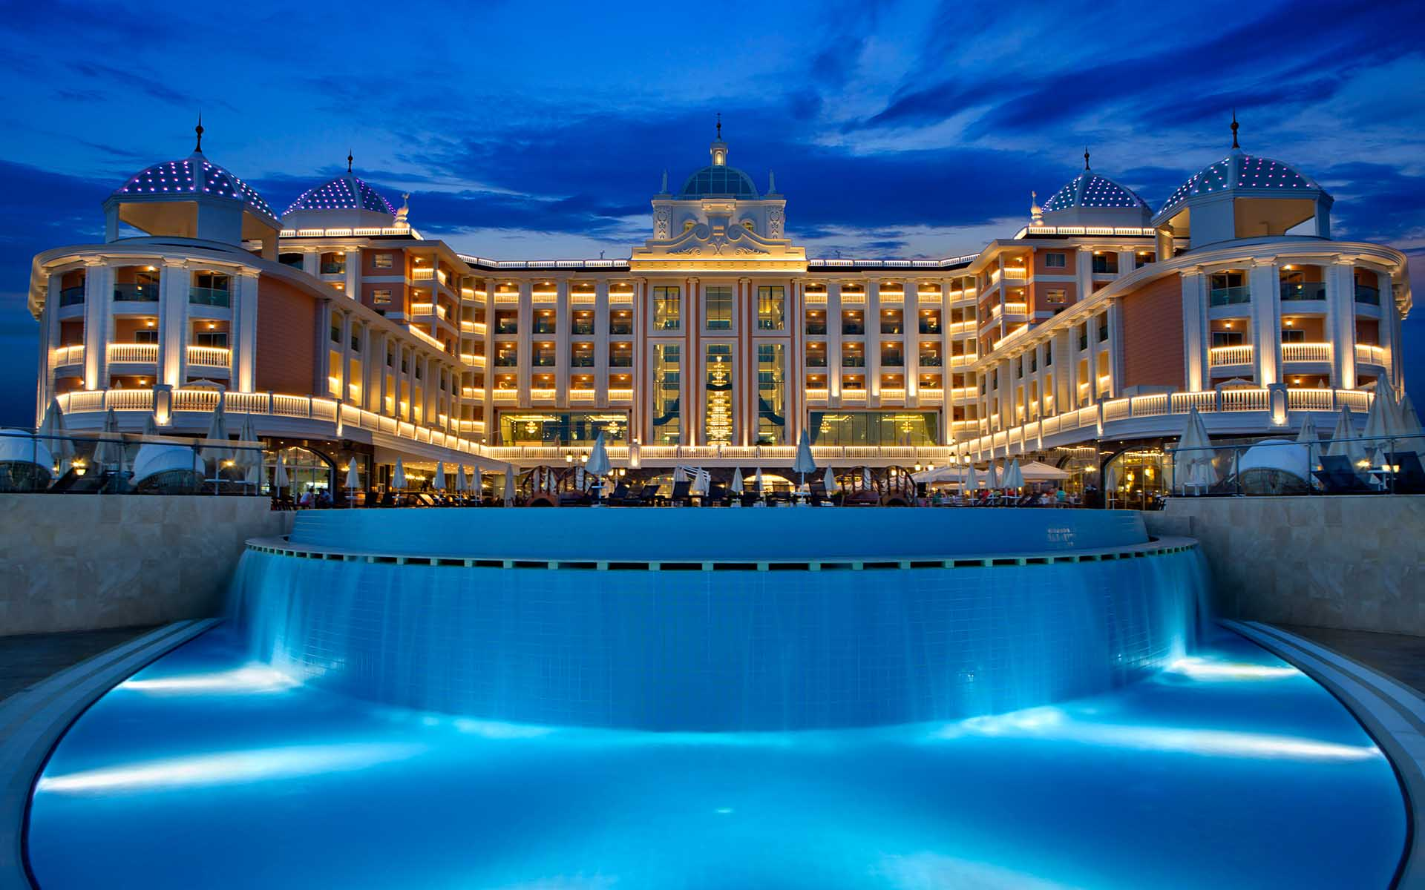
Hotel
Think about if you were to open a new hotel. Before you can take any bookings for guests to stay at your hotel you need to decide and action several things:
Decide where to open your hotel
How many rooms you will have - singles vs doubles etc.
Will there be a pool and restaurant?
Install systems – CCTV, door access systems, Wi-Fi
Employ staff and establish teams for cleaning, reception, maintenance etc.
This relates to Azure Landing Zones (ALZ). As ALZ provides all the platform foundational elements, networking, IAM, policies, security, management, monitoring, etc. that are required before you host/deploy apps and services at scale that are governed and secured.
This Photo by Unknown Author is licensed under CC BY
Notes:
TALK TRACK:
One of the best analogies for understanding a landing zone, is to compare it to the necessary services upon which a city is built. Before buildings can be erected and people move into them essentials services must be in place. Road are necessary for people to move around, water and sewer facilities need to be in place, power and gas lines must be made available. You can think of azure landing zones as the essential platform services required for the different types of applications you will host on Azure. Different applications may require different services, and guardrails, and therefore will live in different landing zones. Similar to zoning codes in real life.
One of the major shifts for a centralized IT organization in this scenario is to move from providing all the infrastructure (building for people to live in) to providing the zoning guides (guardrails to be in place for other business units to build their infrastructure and application upon).
One of the main benefit of the cloud is that you can scale resources based on demand and the there is practically no limit on scale. The same applies for scaling down. Just like you turn on light bulbs when you need it and turn it off when you do not , and you are charged only for the portion of electricity when the light bulb is turn on, you can turn on any VM, resources, IOT or any other resources when you need it and turn it off when you do not . Azure give you better option than turn on and off button, imagine a Dial on light bulb and keep adjusting for the light needed indoor during daytime or night when light keep changing because of sunlight or cloud. There is practically no capital cost associated with IT in the cloud because you are not buying hardware to build data center. You are using everything and anything on demand based on need.
Because of this power of unlimited scale, governance problem arises. Due to sheer number of resources, governance and organization of resources become challenge. After all we like to make our and other lives easier, so we think about solving this problem of governance.
I would like you Imagine a library with a pile of books with no marking and sorting and section and you have to find your particular book, it will be difficult, almost impossible.
The same applies to resources in Azure subscription if its not properly organized and not organized for operational efficiency.
Enterprise scale is the answer to organizing subscription to landing zone. We build landing zone so we would know where to go and provision resources when we need them. Just like in a library when we pick up a book , we know where to go to find it or to place it.
Landing zones help with the adoption of cloud and give you a better way of organizing resources not just its type, but by organization, cost and security.

Slide 8
Azure landing zone architecture
Notes:
With the purpose and core design considerations in mind, lets look at the guidance we provide as part of the Ready methodology in the Cloud Adoption Framework, starting with architecture.

Slide 9
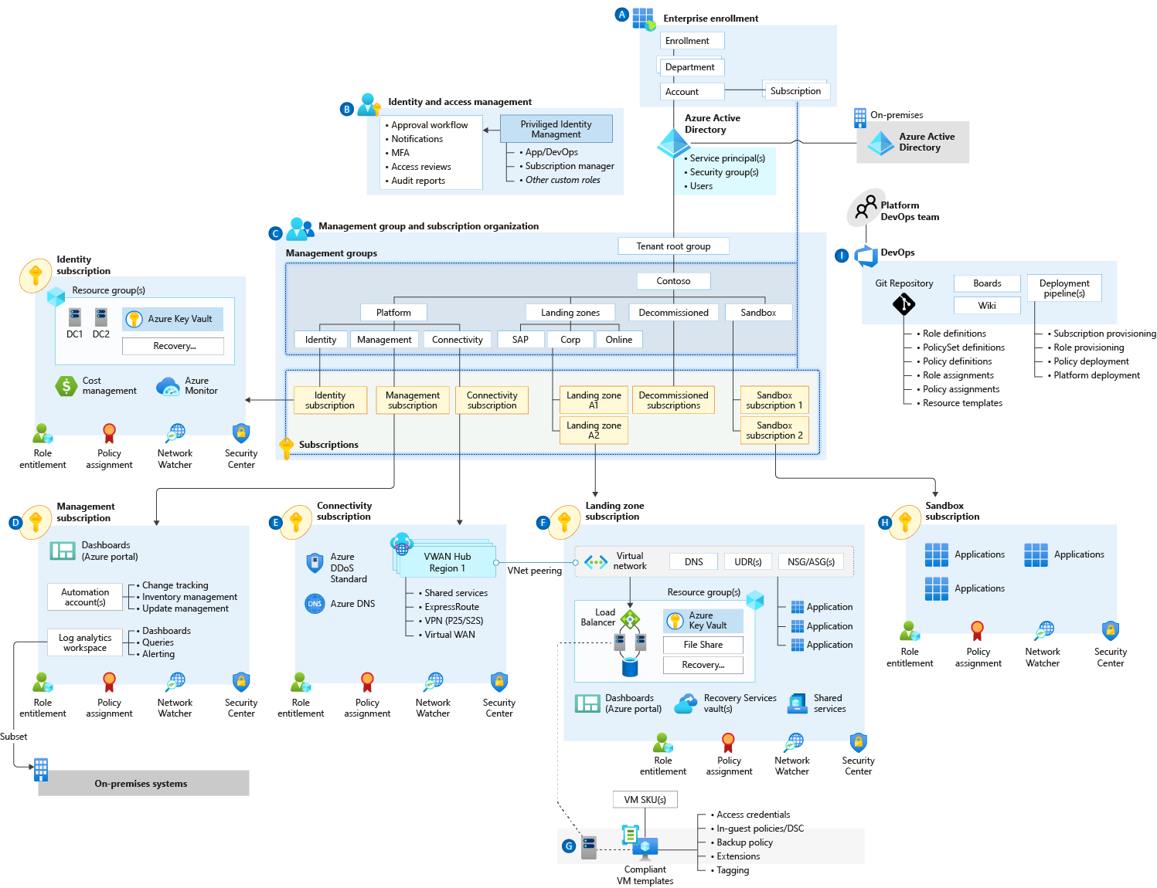
Azure Landing Zones
Notes:
Azure Landing Zones is an architecture approach and reference implementation that enables effective construction and operationalization of landing zones on Azure, at scale and aligned with the Azure roadmap and the Microsoft Cloud Adoption Framework for Azure. The Azure Landing Zones architecture provides prescriptive guidance coupled with Azure best practices, and it follows design principles across the critical design areas for the customer's Azure environment.

Slide 10
Azure Landing Zones Design Principles
Subscription Democratisation
Policy Driven Governance
Single Control and Management Plane
Application Centric and Archetype-Neutral
Azure Native Design and Platform Roadmap Alignment
Enable Autonomy for Innovation and Transformation
Security and Compliance By-Default
Governance At-Scale with Sustainable Cloud Engineering
Notes:
Just like organizing book in library comes with set of principals. Azure Landing Zones comes with set of design principals, which are necessary for organizing resources in subscriptions. There is a purpose behind every single principal which will be discussed during this presentation.
Subscriptions should be used as a unit of management and scale aligned with business needs and priorities. You should avoid to maintain central control for subscription creation, and allow business units to create subscriptions themselves. Your governance model should ensure that as subscriptions are created and moved to different management groups, policies are applied to enforce any necessary guardrails.
Azure Policy should be used to provide the “guard-rails” and ensure the continued compliance of the customer platform and applications deployed onto it, whilst also providing application owners sufficient freedom and a secure unhindered path to cloud.
The Azure Landing Zones architecture should NOT rely on abstraction layers such as customer developed portals or tooling, and should provide a consistent experience for both AppOps (centrally managed operation teams) and DevOps (dedicated application operation teams).
The Azure Landing Zones architecture should focus on application centric migrations and development rather than a pure infrastructure “lift and shift” migration (i.e. movement of virtual machines) and should not differentiate between old/new applications or IaaS/PaaS applications.
The Azure Landing Zones architecture strongly advocates the use of native platform services and capabilities wherever possible, which should be fully aligned with Azure platform roadmaps from the offset to ensure new capabilities are swiftly made available within customer environments.
the use of native platform services and capabilities wherever possible, which should be fully aligned with Azure platform roadmaps from the offset to ensure new capabilities are swiftly made available within customer environments.

Slide 11

Azure landing zones Design areas
Azure billing & Azure Active Directory tenant
Security
Identity & access management
Governance
ENVIRONMENT
COMPLIANCE
Resource organization
Management
Network topology & connectivity
Platform automation & DevOps
Notes:
Design areas (the different parts that make up Azure landing zones) are an important early step in thinking about and designing a landing zone.
Azure billing an Active Directory tenant - Proper tenant creation, enrolment, and billing setup are important early steps.
Identity and access management - Identity and access management is a primary security boundary in the public cloud. It's the foundation for any secure and fully compliant architecture.
Resource organization - As cloud adoption scales, considerations for subscription design and management group hierarchy have an impact on governance, operations management, and adoption patterns.
Network topology and connectivity - Networking and connectivity decisions are an equally important foundational aspect of any cloud architecture.
Security - Implement controls and process to protect your cloud environments
Governance - Automate auditing and enforcement of governance policies.
Management - For stable, ongoing operations in the cloud, a management baseline is required to provide visibility, operations compliance, and protect and recover capabilities.
Platform automation and DevOps - Align the best tools and templates to deploy your landing zones and supporting resources.
Split into Environment and Compliance:
Build vs Run
Starting points vs on-going iterations and refinements
Let's look at how we approach an understanding of how a cloud operating model works.

Slide 12
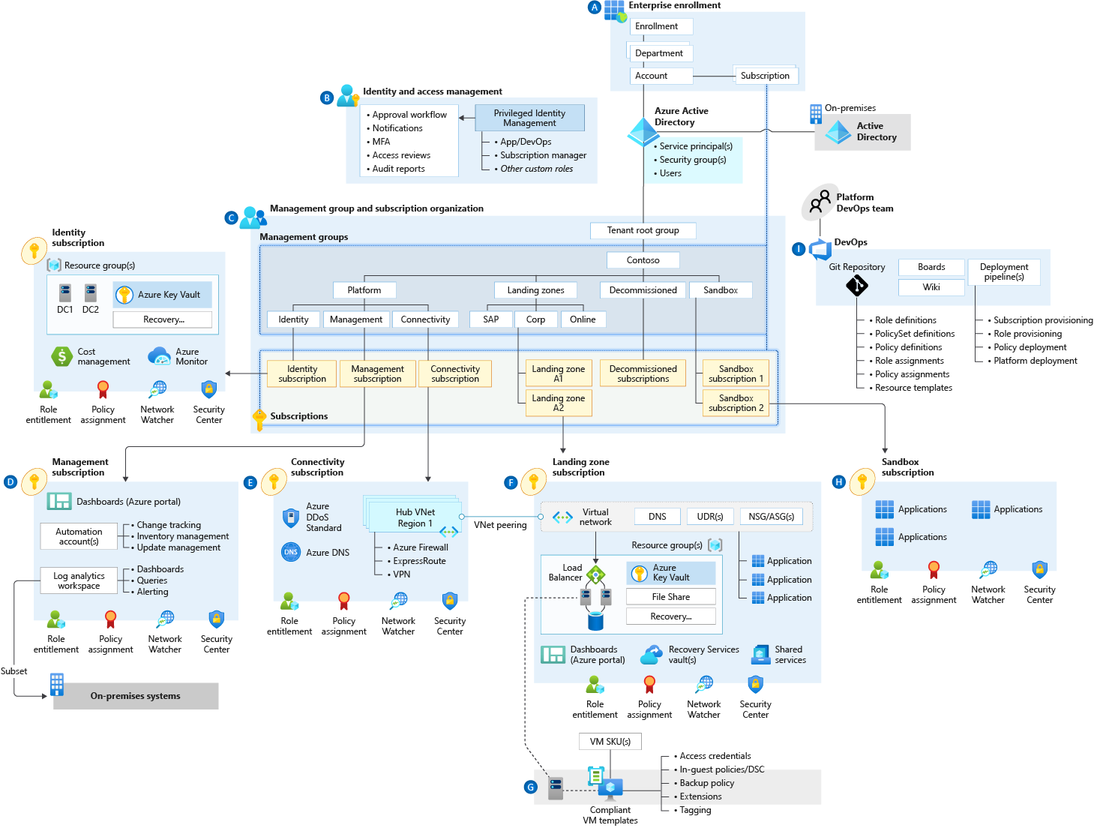
Azure landing zone conceptual architecture What does it represent?
Target end-state for most organizations
Scaled-out and mature environment
Customer and partner practices for environment design across Microsoft
Strong foundation for management, governance, and security processes
Notes:
Azure landing zone conceptual architecture
The destination (or target end-state) of the journey.
Scaled-out controls and architecture to enable customers to grow and innovate safely
Depending on the cloud operating model chosen, you may arrive at this destination quickly, or over time.
This may represent a subset of your estate, if you scale into enterprise operations or distributed operations
We are learning from engagements with customers and partners, codifying best practices guidance for the cloud adoption journey.
Let's dive into common starting points, and the typical phases of a cloud journey.

Slide 13
A Landing Zone The principal purpose of the “Landing Zone” is to ensure that when an application or workload lands on Azure, the required “plumbing” is already in place, providing greater agility and compliance with enterprise security and governance requirements.
Notes:
The CAF Azure Landing Zones landing zone architecture represents the strategic design path and target technical state for the customer's Azure environment. It will continue to evolve in lockstep with the Azure platform and is ultimately defined by the various design decisions the customer organization must make to define their Azure journey.

Slide 14

When do you need customization?
In some scenarios, you can't use a ready-to-deploy implementation:
The implementation doesn’t represent how you operate services.
Your organization has specific controls you require for compliance.
The north star for Azure landing zones remains the conceptual architecture—which customers and partners can use to design and operate successful cloud environments.
We have recommended best practices guidance and tools—to help you deliver a customized experience to design and operate your environments.
More info on “Tailoring ALZ” coming to CAF docs soon!
Notes:
How do you know, as a customer, when you need customization?
With the first bullet, stress the scenarios when customers can't use a ready-to-deploy solution, and will need to customize their environment implementation
Emphasize the "target end-state" of the conceptual architecture as a signpost guiding customers towards successful design and operation of cloud environments.
What if you need a fully featured enterprise-scale implementation—with complete governance and management in place?

Slide 15



Azure Landing Zones Implementation Options
ALZ Accelerator – https://aka.ms/caf/ready/accelerator
Terraform ‘caf-enterprise-scale’ module – https://aka.ms/alz/tf/wiki
Bicep – https://aka.ms/alz/bicep/repo

Slide 16
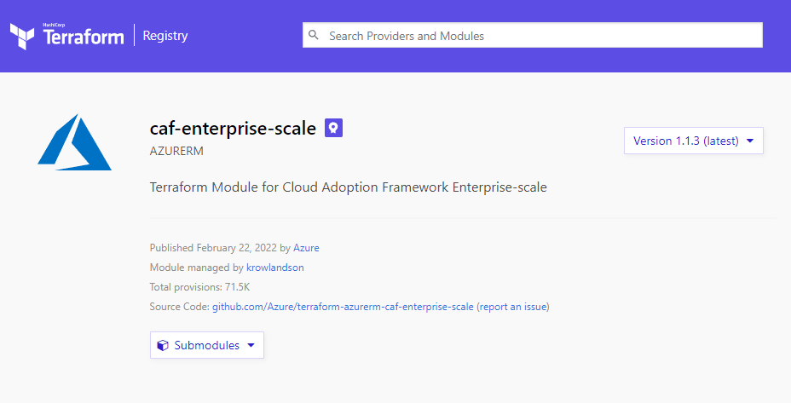
Introducing the `caf-enterprise-scale` Terraform module
aka.ms/alz/tf

Slide 17
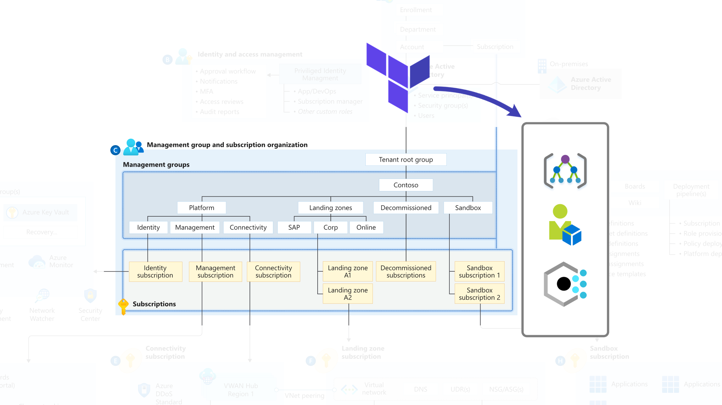
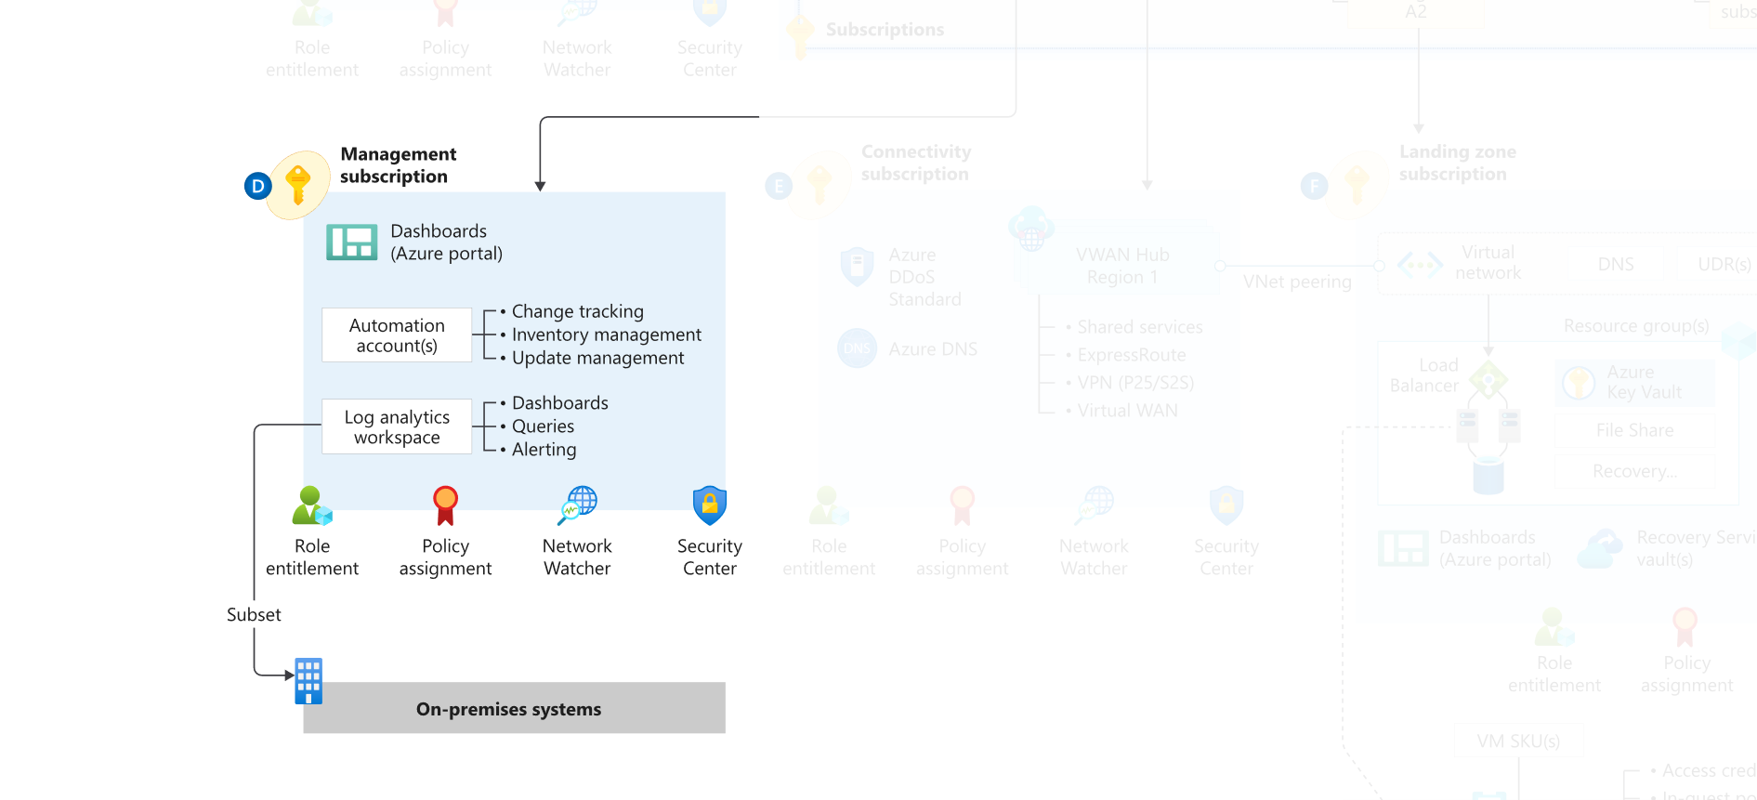
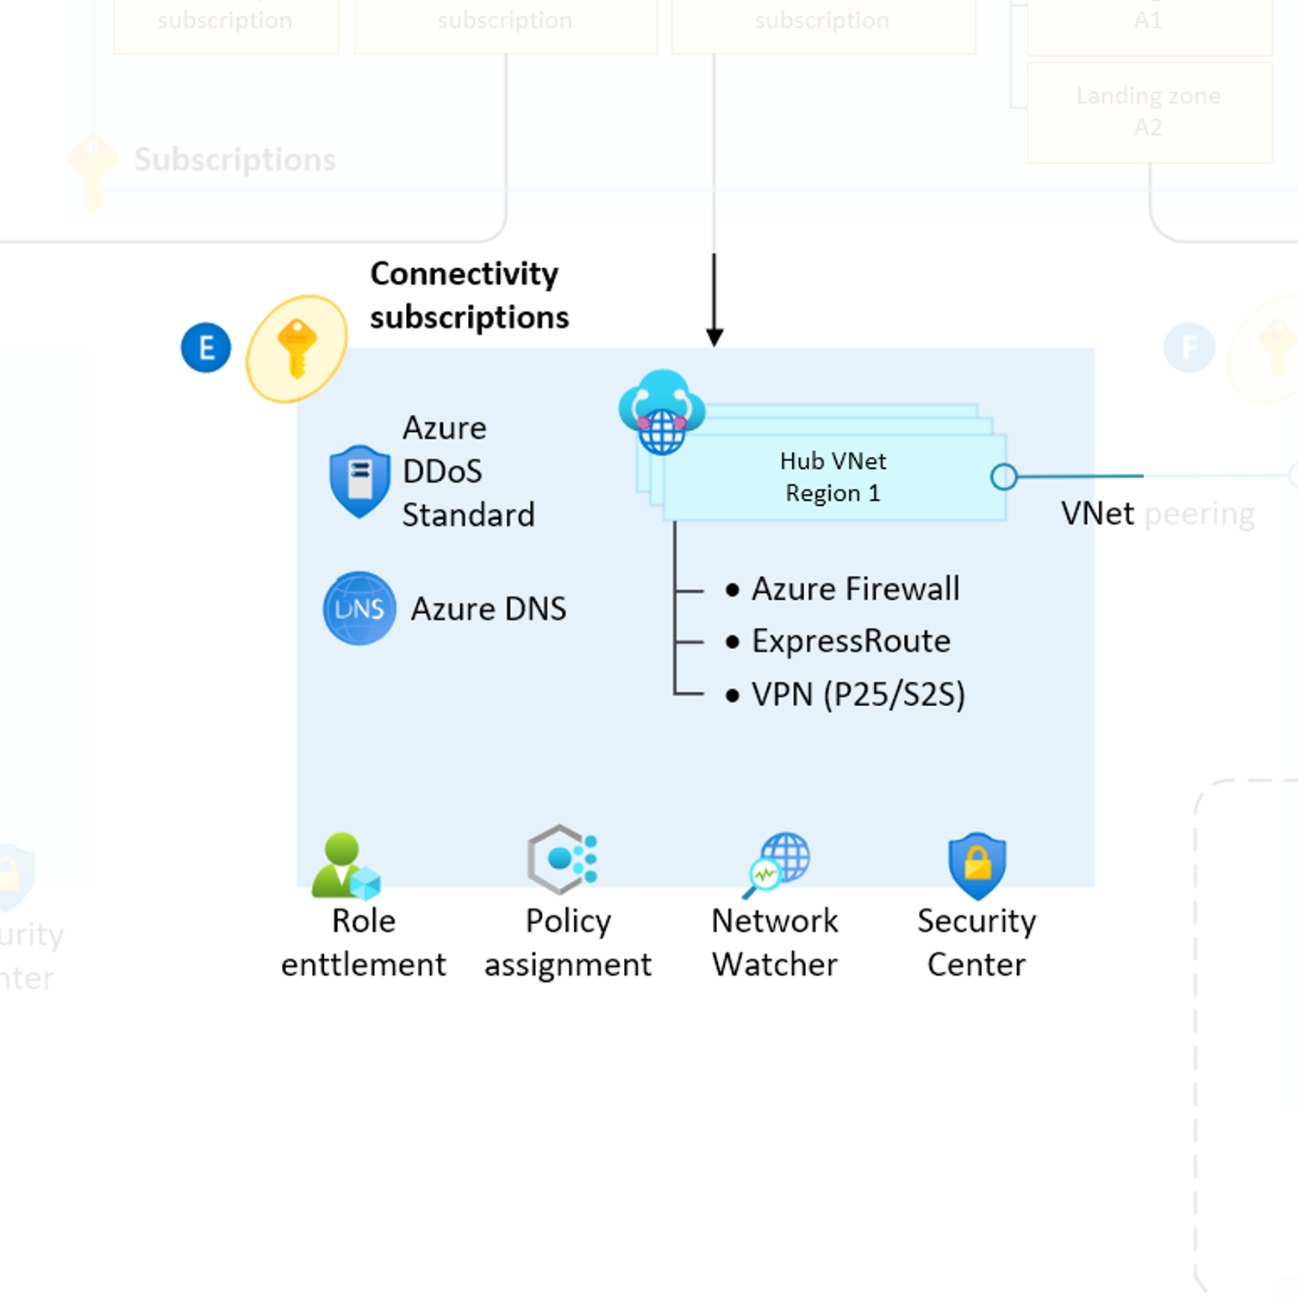
What does it do?
Core resources
Management resources
Connectivity resources
(hub & spoke available now, and vwan coming soon)

Slide 18
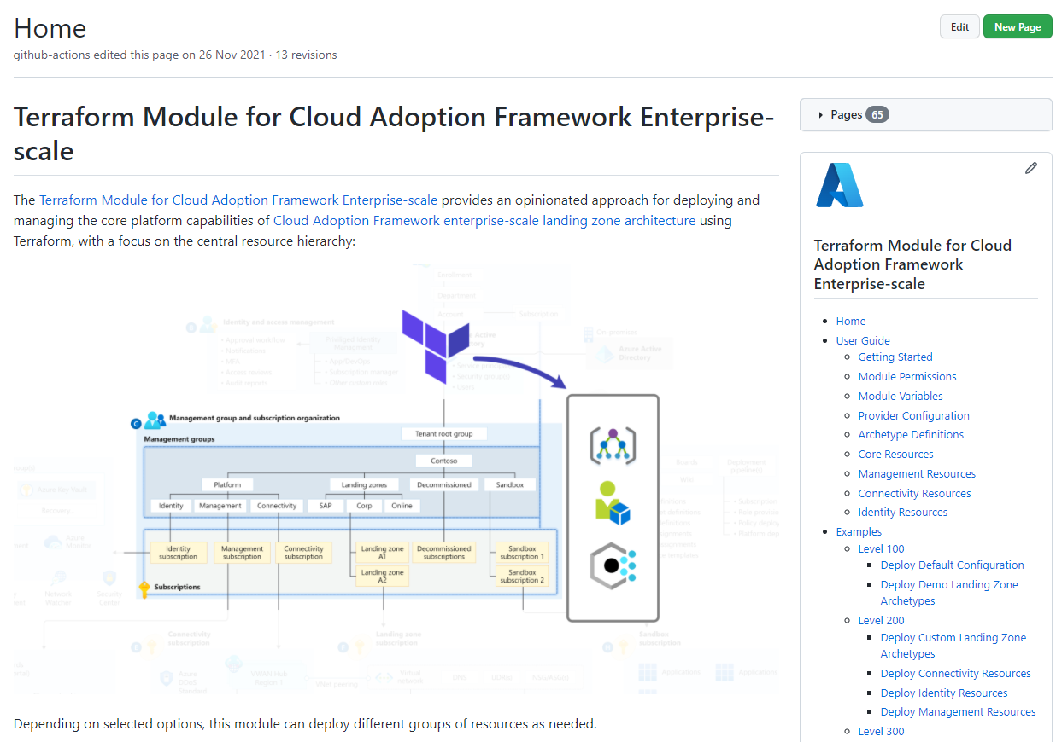
How to use it?
aka.ms/alz/tf/wiki

Slide 19
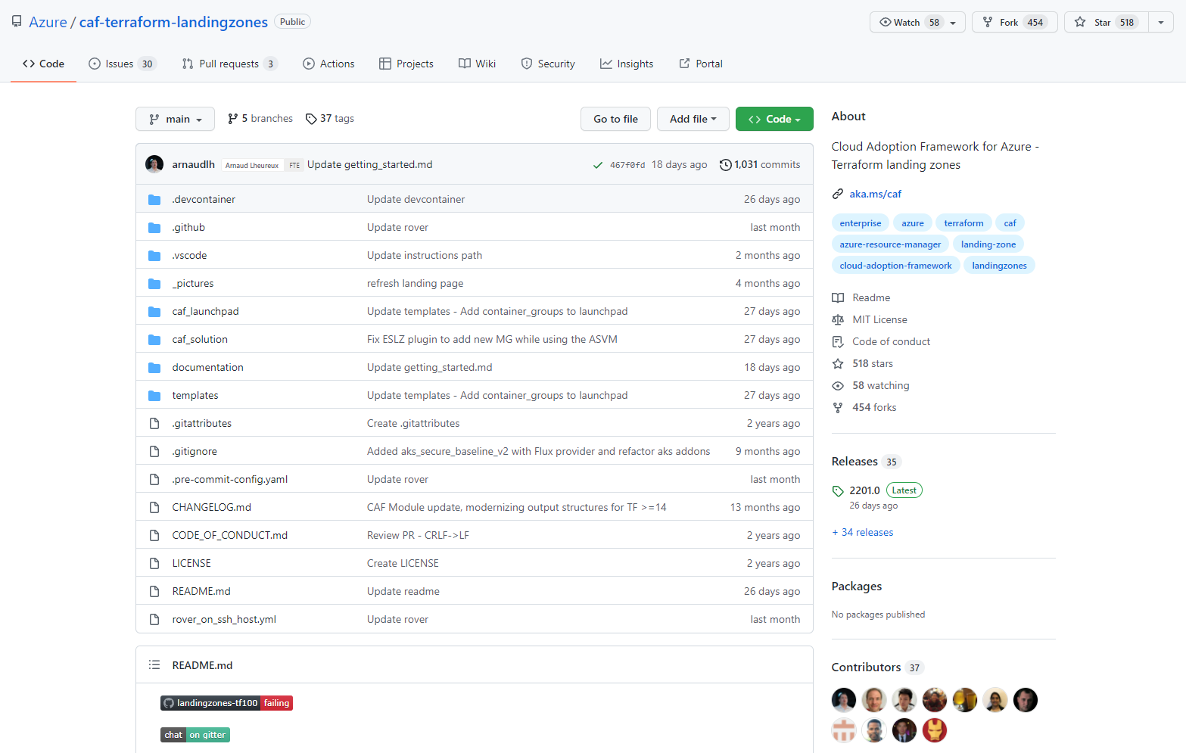
What about the `caf terraform landing zones`?
This is more of a “CAF Framework for Terraform” developed by an inner-source community and used by customers globally.
Provides an opinionated approach for how to use Terraform to manage resource deployments in Azure.
Implements a tiered Terraform state hierarchy using Azure storage for the backend config.
Includes a reference deployment for the caf-enterprise-scale module, but also provides a mechanism for deploying application workloads.
Uses rover, a container-based solution for running Terraform deployments.
Is NOT an alternative to the caf-enterprise-scale module – it provides another way to deploy it!
aka.ms/tf-landingzones

Slide 20
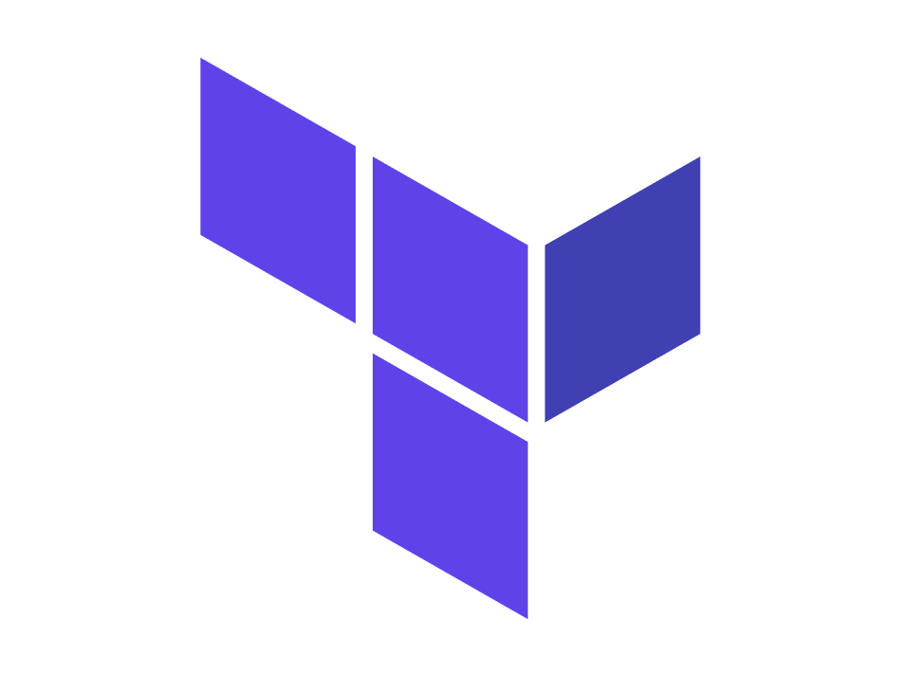
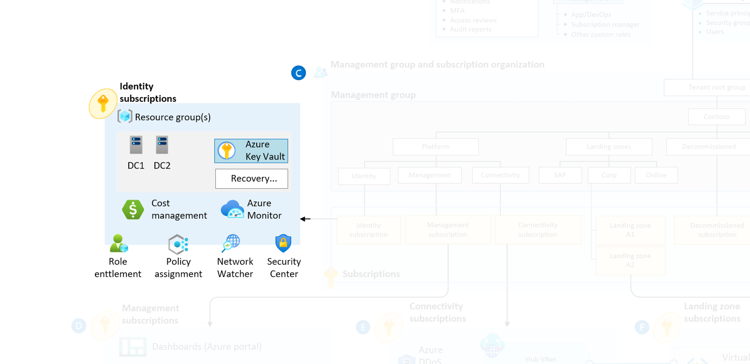
Terraform Modules CAF-Enterprise-Scale
CAF-Enterprise-Scale
Official module authored and maintained by the Enterprise Scale team
Delivers the components included in Enterprise Scale
Native Terraform and can be run anywhere Terraform can be
Parity with other Enterprise Scale implementation options and features
Simple to use, fully customisable if desired
Useable in any operational approach
Notes:
JT

Slide 21
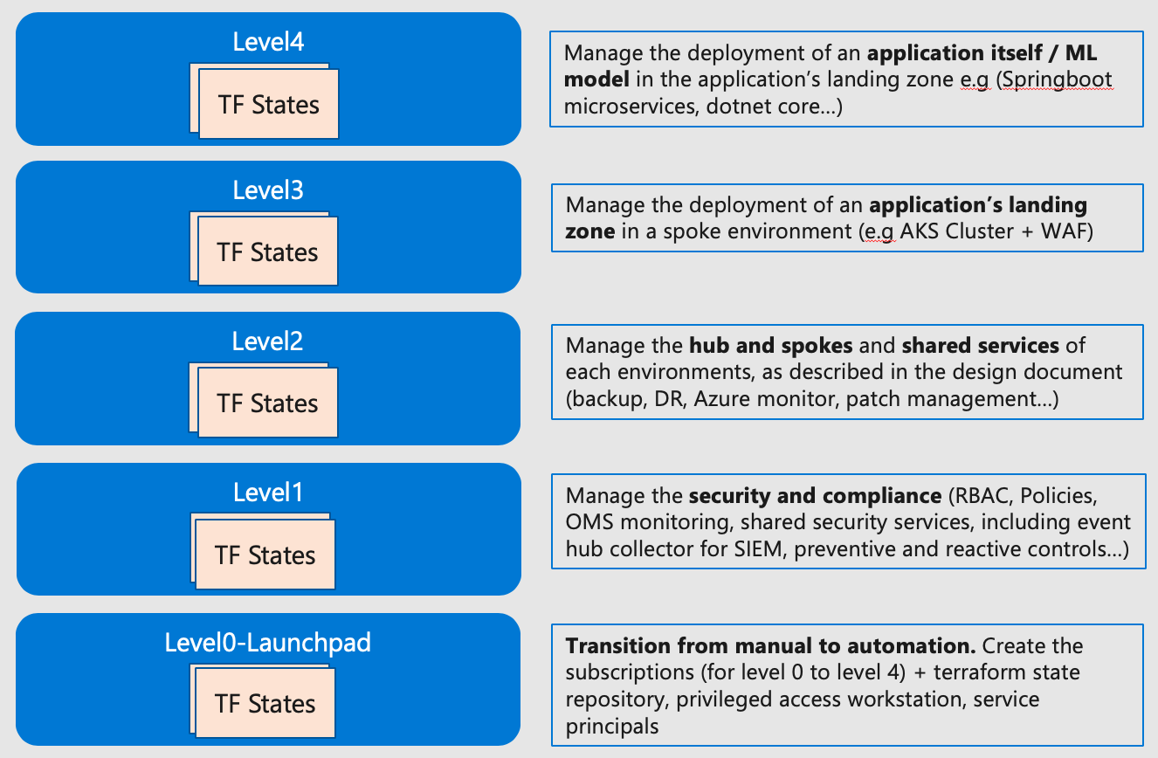
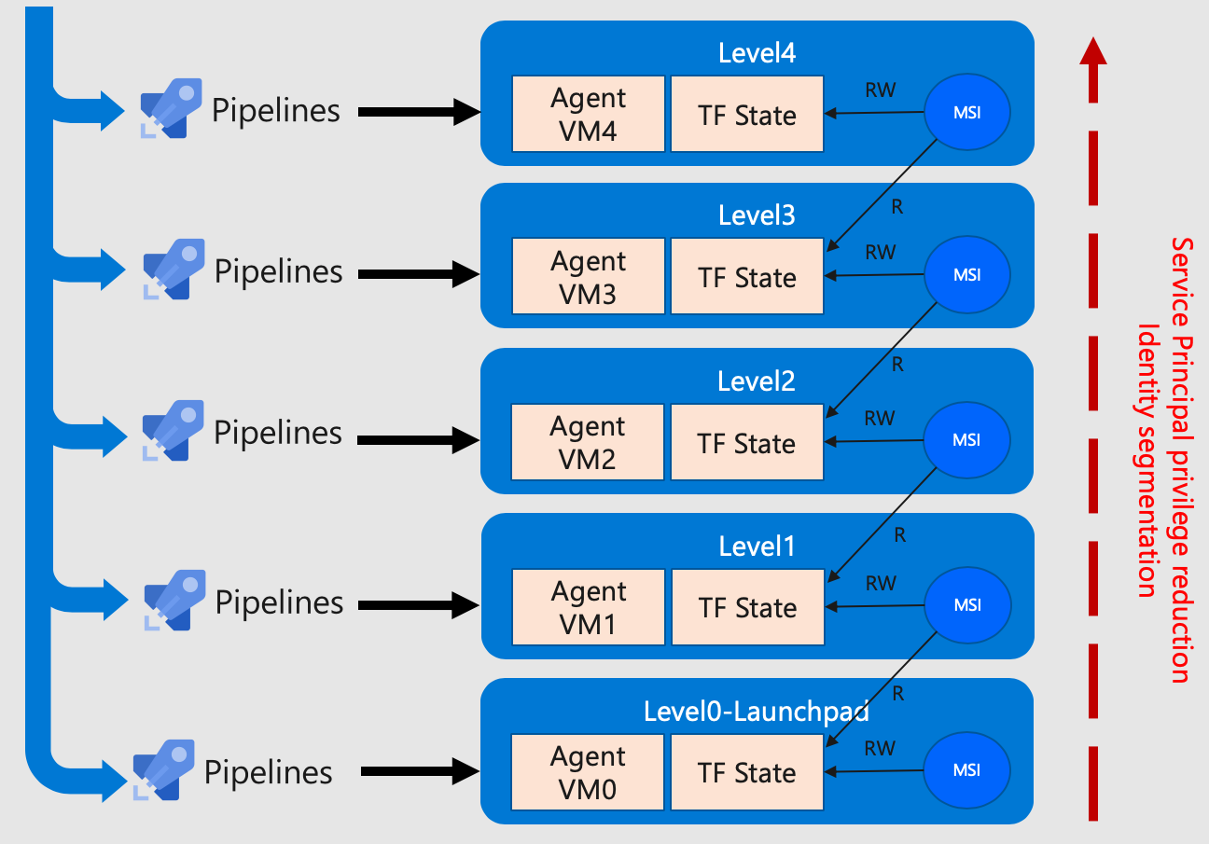
Terraform Modules CAF-Terraform-LandingZones
CAF-Terraform-LandingZones
Module created by Microsoft CSAs in Singapore (Arnaud & Laurent)
Uses a custom container called “Rover” for deployment
Has various "Levels” (0 to 4)
Separate state file and pipeline for each level
Focus is towards workloads and services that live in Landing Zones (see currently supported list here)
Uses the CAF-Enterprise-Scale Module to deploy Enterprise Scale components
Leans towards a centralised operational approach
More info on the docs here
Notes:
JT

Slide 22
What is Terraform?
Provisioning tool
Declarative
Cloud Agnostic
Open Source
Easy to use and read
Free and Open Source
Notes:
HashiCorp Terraform is an infrastructure as code tool that lets you define both cloud and on-prem resources in human-readable configuration files that you can version, reuse, and share. You can then use a consistent workflow to provision and manage all of your infrastructure throughout its lifecycle. Terraform can manage low-level components like compute, storage, and networking resources, as well as high-level components like DNS entries and SaaS features.

Slide 23
Providers
Azure
AWS
Google
Oracle Cloud Infrastructure
Alibaba Cloud
*LOTS* More
Notes:
Providers
Terraform relies on plugins called "providers" to interact with cloud providers, SaaS providers, and other APIs.
Terraform configurations must declare which providers they require so that Terraform can install and use them. Additionally, some providers require configuration (like endpoint URLs or cloud regions) before they can be used.
What Providers Do
Each provider adds a set of resource types and/or data sources that Terraform can manage.
Every resource type is implemented by a provider; without providers, Terraform can't manage any kind of infrastructure.
Most providers configure a specific infrastructure platform (either cloud or self-hosted). Providers can also offer local utilities for tasks like generating random numbers for unique resource names.
Where Providers Come From
Providers are distributed separately from Terraform itself, and each provider has its own release cadence and version numbers.
The Terraform Registry is the main directory of publicly available Terraform providers, and hosts providers for most major infrastructure platforms

Slide 24
State
Local (default)
Terraform Cloud
Azure Storage Account
AWS S3 Bucket
Google Cloud Storage
Notes:
State
Terraform must store state about your managed infrastructure and configuration. This state is used by Terraform to map real world resources to your configuration, keep track of metadata, and to improve performance for large infrastructures.
This state is stored by default in a local file named "terraform.tfstate", but it can also be stored remotely, which works better in a team environment.
Terraform uses this local state to create plans and make changes to your infrastructure. Prior to any operation, Terraform does a refresh to update the state with the real infrastructure.
The primary purpose of Terraform state is to store bindings between objects in a remote system and resource instances declared in your configuration. When Terraform creates a remote object in response to a change of configuration, it will record the identity of that remote object against a particular resource instance, and then potentially update or delete that object in response to future configuration changes.
For more information on why Terraform requires state and why Terraform cannot function without state, please see the page state purpose.

Slide 25
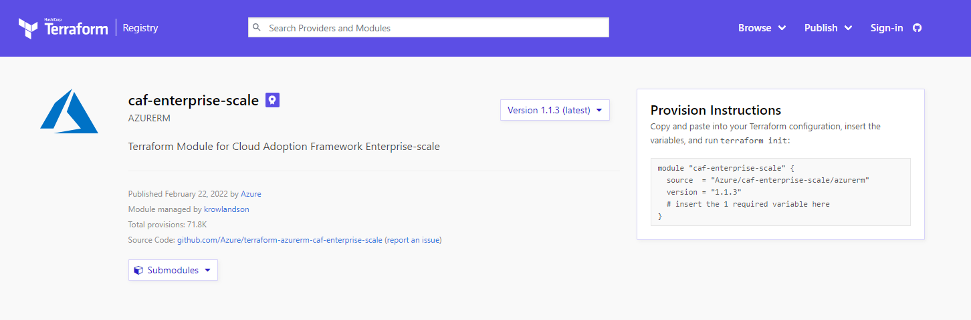
Modules
Notes:
Modules
Hands-on: Try the Reuse Configuration with Modules collection on HashiCorp Learn.
Modules are containers for multiple resources that are used together. A module consists of a collection of .tf and/or .tf.json files kept together in a directory.
Modules are the main way to package and reuse resource configurations with Terraform.
»The Root Module
Every Terraform configuration has at least one module, known as its root module, which consists of the resources defined in the .tf files in the main working directory.
»Child Modules
A Terraform module (usually the root module of a configuration) can call other modules to include their resources into the configuration. A module that has been called by another module is often referred to as a child module.
Child modules can be called multiple times within the same configuration, and multiple configurations can use the same child module.
»Published Modules
In addition to modules from the local filesystem, Terraform can load modules from a public or private registry. This makes it possible to publish modules for others to use, and to use modules that others have published.
The Terraform Registry hosts a broad collection of publicly available Terraform modules for configuring many kinds of common infrastructure. These modules are free to use, and Terraform can download them automatically if you specify the appropriate source and version in a module call block.
Also, members of your organization might produce modules specifically crafted for your own infrastructure needs. Terraform Cloud and Terraform Enterprise both include a private module registry for sharing modules internally within your organization.
»Using Modules
Module Blocks documents the syntax for calling a child module from a parent module, including meta-arguments like for_each.
Module Sources documents what kinds of paths, addresses, and URIs can be used in the source argument of a module block.
The Meta-Arguments section documents special arguments that can be used with every module, including providers, depends_on, count, and for_each.

Slide 26
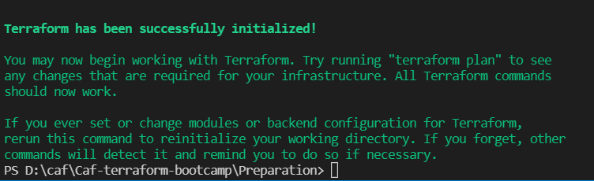
Initializing Terraform
‘Terraform Init’
Module Installation
Backend Initialization
Plugin Installation
Notes:
The terraform init command is used to initialize a working directory containing Terraform configuration files. This is the first command that should be run after writing a new Terraform configuration or cloning an existing one from version control. It is safe to run this command multiple times.
Usage
Usage: terraform init [options]
This command performs several different initialization steps in order to prepare the current working directory for use with Terraform. More details on these are in the sections below, but in most cases it is not necessary to worry about these individual steps.
This command is always safe to run multiple times, to bring the working directory up to date with changes in the configuration. Though subsequent runs may give errors, this command will never delete your existing configuration or state.

Slide 27
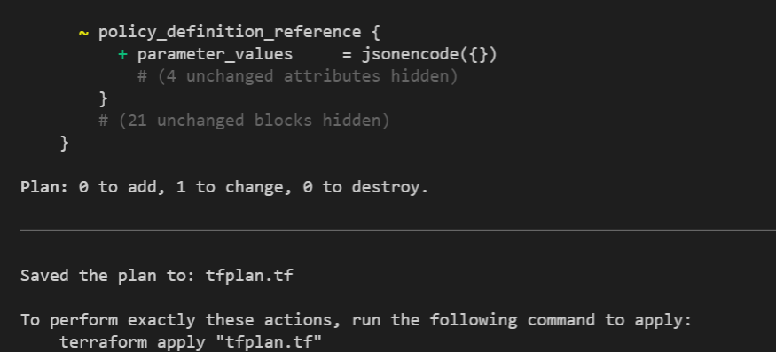
Generating an Execution Plan
‘Terraform Plan’
‘Terraform Plan’ –out tfplan.tf
Notes:
The terraform plan command creates an execution plan, which lets you preview the changes that Terraform plans to make to your infrastructure. By default, when Terraform creates a plan it:
Reads the current state of any already-existing remote objects to make sure that the Terraform state is up-to-date.
Compares the current configuration to the prior state and noting any differences.
Proposes a set of change actions that should, if applied, make the remote objects match the configuration.

Slide 28
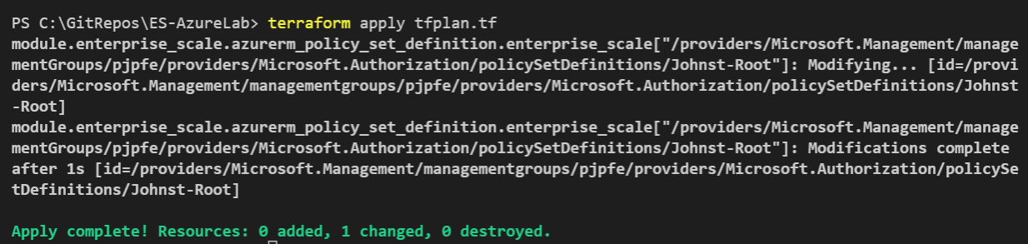
Executing your plan
‘Terraform Apply’
‘Terraform Apply’ tfplan.tf
‘Terraform Apply’ –auto-approve
‘Terraform Apply’ –auto-approve –parallelism 50
Notes:
The terraform apply command executes the actions proposed in a Terraform plan.
The most straightforward way to use terraform apply is to run it without any arguments at all, in which case it will automatically create a new execution plan (as if you had run terraform plan) and then prompt you to approve that plan, before taking the indicated actions.
Another way to use terraform apply is to pass it the filename of a saved plan file you created earlier with terraform plan -out=..., in which case Terraform will apply the changes in the plan without any confirmation prompt. This two-step workflow is primarily intended for when running Terraform in automation.

Slide 29
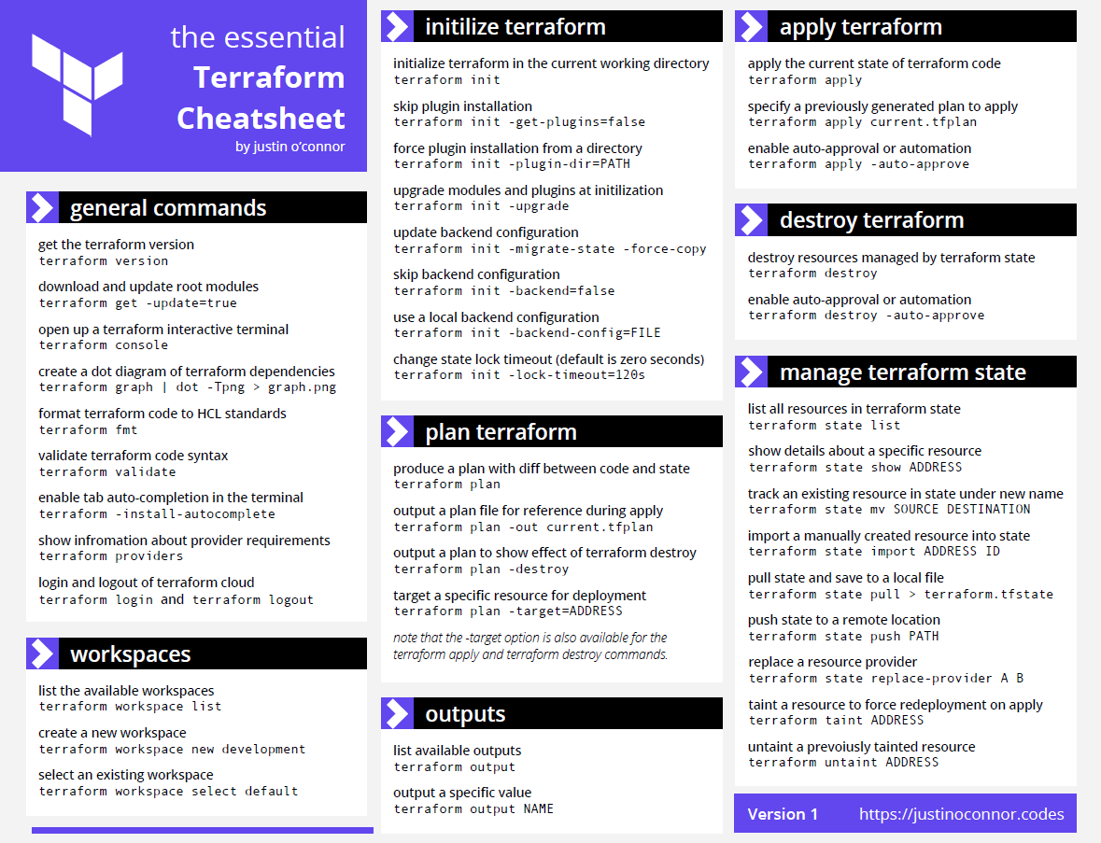

Slide 30
Introduction
Contoso is a retail and manufacturing enterprise company with global presence mainly across North America and EMEA. The company has multiple locations across the world with two main datacentres in Los Angeles and Madrid in which they run over 5000 servers. At a smaller scale, there are nearly 100 other locations such as branch offices, plants or retail stores across multiple countries. A few years ago, Contoso started using O365 and Azure as part of the company’s digital transformation plan. Before 2015, Azure in classic mode was used for some dev and production web applications. After the release of Azure Resource Manager in GA, new workloads have been deployed based on Azure Resource Manager.
Contoso is working close with Microsoft to establish model how to manage new multisubscription Azure environment that accounts for scale, security governance, networking, and identity and prepare Azure environment for application migration, modernization, and innovation at enterprise-scale in Azure. Microsoft will conduct CAF MIP workshops (Assessment, Design and Implementation) to create and implement architecture design that is based on the Enterprise Scale reference architecture from Microsoft.

Slide 31
Azure Landing Zone Design
During their design session, conducted as CAF Design MIP, Contoso decided to follow the Enterprise Scale reference architecture and to implement Management Group structure customizing landing zone Management Group organization only, and adding or removing specific Azure policies and initiatives.
A detailed list of changes that need to be made regarding policies will be specified for each Management Group. Changes defined later in this document must be made against reference deployment using the Terraform Module for Cloud Adoption Framework Enterprise-scale.
The implementation will be completed using the Terraform Module for Cloud Adoption Framework Enterprise-scale Azure/caf-enterprise-scale/azurerm | Terraform Registry.

Slide 32
General Information
Contoso will use two Azure regions - West Europe & North Europe with West Europe as their primary region.
Landing Zone admins should not be able to deploy resources in any other regions.

Slide 33
Tenant and subscription information
Tenant information: AzInWCB094outlook.onmicrosoft.com
Subscriptions:
Subscription name | Subscription ID
ES-CE-CUS-MS-Prjelesi-IDENTITY | a2ee4c37-079e-47e1-b62a-xxxxxxxxxxxx
ES-CE-CUS-MS-Prjelesi-CONNECTIVITY | 3df4c0a1-72a4-4b44-93c2-xxxxxxxxxxxx
ES-CE-CUS-MS-Prjelesi-MANAGEMENT | cbee308f-16b1-4387-a051-xxxxxxxxxxxx
ES-CE-CUS-MS-Prjelesi-LANDINGZONE | c46d37cb-013f-4335-bca3-xxxxxxxxxxxx
ES-CE-CUS-MS-Prjelesi-SANDBOX | 2df3950c-4318-4599-b882-xxxxxxxxxxxx
Please change tenant name and subscriptions based on personal subscriptions that you will use during the bootcamp

Slide 34
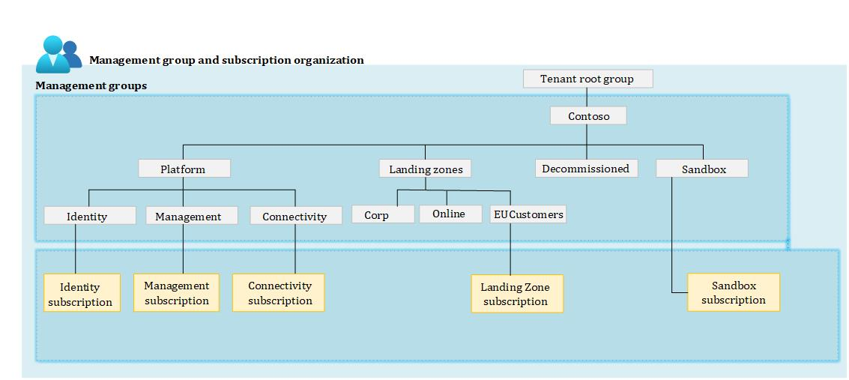
Management Group and Subscription Organization - Management Group Hierarchy
Design Decision
Contoso will implement a Management Group structure as per the diagram below: Root name: Contoso Root ID: Contoso Assign reader role to Azure AD group with name “ContosoGlobalReaders” on the entire Management Group structure and all the subscriptions beneath. Group ObjectID: 8d3a3c7e-0463-4d18-bb67-1f0f786ff2fa

Slide 35
Management Group and Subscription Organization - Management Group Hierarchy
Design Decision
Landing Zone Management Group additional configuration : The 'Corp' and 'Online' Management Groups will be created automatically with Microsoft recommended configuration The 'EUCustomers' Management Group will be created manually. Azure policy will be used at this scope to prevent resource deployments to regions other than West or North Europe. Resources in subscriptions that are under Landing Zone Management Group must be deployed with defined criticality tag. Criticality tag must have at least one of values '1', '2' or '3' Create Landing Zone baseline tag policy initiative that include Criticality tag policy. 'GlobalLZEUOwners' must have owner rights on 'EUCustomers' Management Group. Users can not attach NSG to network interfaces for subscription under ‘EUCustomers’ Management Group. Contoso Management Group additional configuration Hybrid use benefit must be enforced on all VMs running on subscription under Contoso Management Group Users should not be able to create Azure AD DomainServices, B2C tenants and Directories except in subscriptions that are under identity Management Group Create custom Security Administrator role with a horizontal view across the entire Azure estate and the Azure Key Vault purge policy

Slide 36
Platform - Network Topology and Connectivity
Contoso will establish a Hub & Spoke network topology in Azure with two hub networks. Connectivity to on-premises is not needed in the first phase. Azure firewall will be deployed in both HUB networks. Landing Zone network will be connected to the hub vNet in West Europe.
Private DNS zones will be enabled and linked to the appropriate vNets. Contoso will use ‘contoso.demo’ as a Private DNS zone.
Hub1:
Address space: 10.100.0.0/16
Location: West Europe
DDOS protection: No
DNS servers: Update to Azure FW IP after deployment
Azure Firewall:
Address space : 10.100.0.0/24
DNS proxy enabled
Hub2:
Address space: 10.200.0.0/16
Location: North Europe
DDOS protection: No
DNS servers: Update to Azure FW IP after deployment
Subnets:
Azure Firewall:
Address space : 10.200.0.0/24
DNS proxy enabled
All resources deployed as part of connectivity subscription must have tag “BelongsTo” with value “Connectivity”

Slide 37
Platform - Identity & Management
Identity
Any subscription that lives within the ‘Identity’ Management Group, users should not be able:
Deploy a public IP
Allow RDP from internet
Management
A central Log Analytics Workspace will be deployed, and virtual machines should be automatically onboarded to send data to the central log analytics WS. Agent health assessment solution will be used to monitor the agent state.
Sentinel will be enabled.
Microsoft Defender for cloud will be enabled and configured:
Security contact pj@contoso.com
Defender will be enabled for:
Servers
Storage
All resources deployed as part of connectivity must have the tag “BelongsTo” with a value of “Management”

Slide 38
Next Step - Lab

Slide 39
Lab Prerequisites
You are required to kindly fulfil the following pre-requisites ahead of the bootcamp in order to be able to successfully complete the bootcamp.
Have an external Subscription (non-Microsoft tenant), for details on how to get one, please visit this link.
A workstation with Azure CLI, Terraform & Visual Studio Code installed and with connectivity to the internet.
Complete the learning path for CAF ALZ (ESLZ) & Terraform.
Grant rights on root Management Group
Deploying Enterprise Scale Pre requisites · Azure/Enterprise-Scale Wiki (github.com)
https://github.com/prjelesi/Caf-terraform-bootcamp

Slide 40
Verify Lab Prerequisites
Visual studio code installation - Download Visual Studio Code - Mac, Linux, Windows
Add terraform extension
Terraform for windows download and unpack to c:\terraform
Configure environment path
Download and install Git for windows
https://git-scm.com/download/win
Download and install azure cli
https://aka.ms/installazurecliwindows

Slide 41
1. Initial configuration
From the IDE environment (Azure CLI, Terraform & Visual Studio Code) that you plan to use navigate to the folder where you will store your files for this lab and create new files with the below names and extensions:
terraform.tf
variables.tf
main.tf
When you create these files, proceed to the next slide.

Slide 42
1. Initial configuration – main.tf file
# Get the current client configuration from the AzureRM provider.
# This is used to populate the root_parent_id variable with the
# current Tenant ID used as the ID for the "Tenant Root Group"
# Management Group.
data "azurerm_client_config" "core" {}
# Declare the Terraform Module for Cloud Adoption Framework
# Enterprise-scale and provide a base configuration.
module "enterprise_scale" {
source = "Azure/caf-enterprise-scale/azurerm"
version = "5.0.0"
providers = {
azurerm = azurerm
azurerm.connectivity = azurerm.connectivity
azurerm.management = azurerm.management
}
root_parent_id = data.azurerm_client_config.core.tenant_id
root_id = var.root_id
root_name = var.root_name
deploy_core_landing_zones = false
}
Copy & paste the content marked in red on the right-hand side in to your ‘main.tf’ file and save it.
Notes:
# Get the current client configuration from the AzureRM provider.
# This is used to populate the root_parent_id variable with the
# current Tenant ID used as the ID for the "Tenant Root Group"
# Management Group.
data "azurerm_client_config" "core" {}
# Declare the Terraform Module for Cloud Adoption Framework
# Enterprise-scale and provide a base configuration.
module "enterprise_scale" {
source = "Azure/caf-enterprise-scale/azurerm"
version = “5.0.0"
providers = {
azurerm = azurerm
azurerm.connectivity = azurerm.connectivity
azurerm.management = azurerm.management
azurerm.identity = azurerm.identity
}
root_parent_id = data.azurerm_client_config.core.tenant_id
root_id = var.root_id
root_name = var.root_name
deploy_core_landing_zones = false
}

Slide 43
1. Initial configuration – terraform.tf file
terraform {
required_providers {
azurerm = {
source = "hashicorp/azurerm"
version = ">= 2.97.0"
}
}
}
provider "azurerm" {
features {}
}
provider "azurerm" {
alias = "eulz"
subscription_id = var.eulzSubscriptionId
features {}
}
provider "azurerm" {
alias = "connectivity"
subscription_id = var.connectivitySubscriptionId
features {}
}
provider "azurerm" {
alias = "management"
subscription_id = var.managementSubscriptionId
features {}
}
provider "azurerm" {
alias = "identity"
subscription_id = var.identitySubscriptionId
features {}
}
provider "azurerm" {
alias = "sandbox"
subscription_id = var.sandboxSubscriptionId
features {}
}
Copy and paste the text marked in blue on the right-hand side in to your ‘terraform.tf’ file and save it.

Slide 44
1. Initial configuration – variables.tf file
variable "root_id" {
type = string
default = "contoso"
}
variable "root_name" {
type = string
default = "contoso"
}
variable "managementSubscriptionId" {
type = string
default = "enter management subscription ID"
}
variable "connectivitySubscriptionId" {
type = string
default = " enter connectivity subscription ID "
}
variable "identitySubscriptionId" {
type = string
default = "enter identity subscription ID "
}
variable "eulzSubscriptionId" {
type = string
default = " enter Landing Zone subscription ID "
}
variable "sandboxSubscriptionId" {
type = string
default = " enter Sandbox subscription ID "
}
variable "primary_location" {
type = string
default = "westeurope"
}
Copy and paste the text marked in green on the right-hand side in to your ‘variables.tf’ file.
Make sure to replace the highlighted text with the subscription IDs that you will use during this lab and save the file.

Slide 45
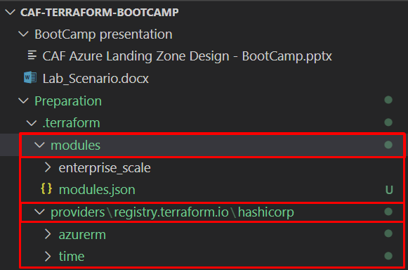
1. Initialize terraform and download module
From your terminal of choice, execute:
terraform init
Verify that terraform has been successfully initialized and that the ‘enterprise_scale’ module has been downloaded to ‘.terraform\modules’.

Slide 46
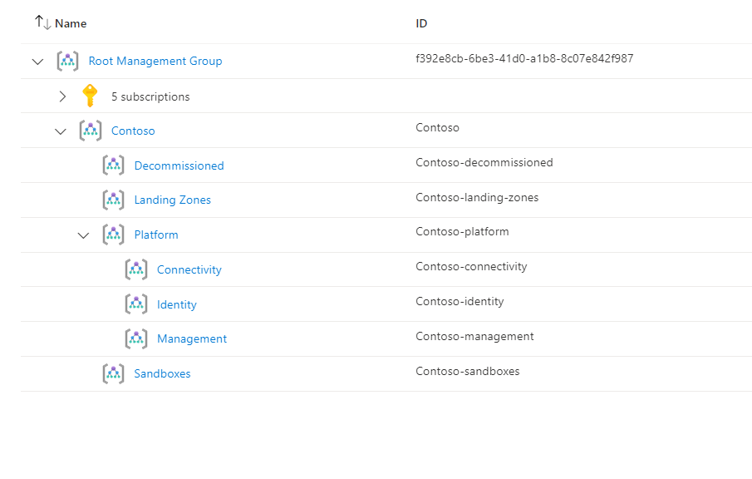
2. Deploy core Management Group structure
In your ‘main.tf’ file change;
deploy_core_landing_zones = false
to
deploy_core_landing_zones = true
Save the ‘main.tf’ file
Create and review a deployment plan by executing terraform plan from your terminal
If you’re happy with your plan, execute terraform apply -auto-approve -parallelism=50
After deployment verify your Management Group structure and policy assignments. The Management Group hierarchy should be the same as the diagram on the right-hand side.
Azure/caf-enterprise-scale/azurerm | Terraform Registry

Slide 47
3. Deploy management resources
To deploy management resources, we will use the guide from the link below
[Examples] Deploy Management Resources With Custom Settings · Azure/terraform-azurerm-caf-enterprise-scale Wiki (github.com)
Step1: Add additional variables to ‘variables.tf’ file
variable "management_resources_location" {
type = string
default = "westeurope"
}
variable "management_resources_tags" {
type = map(string)
default = {
BelongsTo = "management"
}
}
variable "log_retention_in_days" {
type = number
default = 50
}
variable "security_alerts_email_address" {
type = string
default = "pj@contoso.com"
}

Slide 48
3. Deploy management resources
To deploy management resources, we will use the guide from the link below
[Examples] Deploy Management Resources With Custom Settings · Azure/terraform-azurerm-caf-enterprise-scale Wiki (github.com)
Step2: Add additional configuration to ‘main.tf’ file
deploy_management_resources = true
subscription_id_management = var.managementSubscriptionId
configure_management_resources = local.configure_management_resources

Slide 49
3. Deploy management resources
# Configure the management resources settings.
locals {
configure_management_resources = {
settings = {
log_analytics = {
enabled = true
config = {
retention_in_days = var.log_retention_in_days
enable_monitoring_for_arc = true
enable_monitoring_for_vm = true
enable_monitoring_for_vmss = true
enable_solution_for_agent_health_assessment = true
enable_solution_for_anti_malware = false
enable_solution_for_azure_activity = false
enable_solution_for_change_tracking = false
enable_solution_for_service_map = false
enable_solution_for_sql_assessment = false
enable_solution_for_updates = false
enable_solution_for_vm_insights = false
enable_sentinel = true
}
}
security_center = {
enabled = true
config = {
email_security_contact = var.security_alerts_email_address
enable_defender_for_acr = true
enable_defender_for_app_services = false
enable_defender_for_arm = false
enable_defender_for_dns = false
enable_defender_for_key_vault = false
enable_defender_for_kubernetes = false
enable_defender_for_oss_databases = false
enable_defender_for_servers = true
enable_defender_for_sql_servers = false
enable_defender_for_sql_server_vms = false
enable_defender_for_storage = true
}
}
}
location = var.management_resources_location
tags = var.management_resources_tags
advanced = null
}
}
To deploy management resources, we will use the guide from the link below
[Examples] Deploy Management Resources With Custom Settings · Azure/terraform-azurerm-caf-enterprise-scale Wiki (github.com)
Step3: Create a new file named ‘settings.management.tf’ and copy the code provided on right side into the file.
Step 4:
Save files
Plan deployment: execute terraform plan
Execute terraform apply -auto-approve
After deployment verify configuration

Slide 50
4. Assign Identity Policies
To deploy identity resources, we will use the guide from the link below
[Examples] Deploy Identity Resources With Custom Settings · Azure/terraform-azurerm-caf-enterprise-scale Wiki (github.com)
Step 1: Add additional configuration to ‘main.tf’ file
deploy_identity_resources = true
subscription_id_identity = var.identitySubscriptionId
configure_identity_resources = local.configure_identity_resources

Slide 51
4. Assign Identity Policies
To deploy identity resources, we will use the guide from the link below
[Examples] Deploy Identity Resources With Custom Settings · Azure/terraform-azurerm-caf-enterprise-scale Wiki (github.com)
Step 2: Create a new file named settings.identity.tf and copy the code provided on the right side into the file
# Configure the identity resources settings.
locals {
configure_identity_resources = {
settings = {
identity = {
enabled = true
config = {
enable_deny_public_ip = true
enable_deny_rdp_from_internet = true
enable_deny_subnet_without_nsg = false
enable_deploy_azure_backup_on_vms = false
}
}
}
}
}
Step 3:
Save files
Plan deployment: execute terraform plan
Execute terraform apply -auto-approve
After deployment verify configuration

Slide 52
5. Deploy connectivity resources
To deploy the connectivity resources, we will use the guide from the link bellow
[Examples] Deploy Connectivity Resources With Custom Settings · Azure/terraform-azurerm-caf-enterprise-scale Wiki (github.com)
Step1: Add additional variables to ‘variables.tf’ file
variable "connectivity_resources_location" {
type = string
default = "westeurope"
}
variable "connectivity_resources_tags" {
type = map(string)
default = {
BelongsTo = "Connectivity"
}
}

Slide 53
5. Deploy connectivity resources
To deploy the connectivity resources, we will use the guide from the link bellow
[Examples] Deploy Connectivity Resources With Custom Settings · Azure/terraform-azurerm-caf-enterprise-scale Wiki (github.com)
Step2: Add additional configuration to ‘main.tf’ file
deploy_connectivity_resources = true
subscription_id_connectivity = var.connectivitySubscriptionId
configure_connectivity_resources = local.configure_connectivity_resources

Slide 54
5. Deploy connectivity resources
# Configure the connectivity resources settings.
locals {
configure_connectivity_resources = {
settings = {
hub_networks = [
{
enabled = true
config = {
address_space = ["10.100.0.0/16", ]
location = "westeurope"
link_to_ddos_protection_plan = false
dns_servers = []
bgp_community = ""
subnets = []
virtual_network_gateway = {
enabled = false
config = {
address_prefix = "10.100.1.0/24"
gateway_sku_expressroute = "ErGw2AZ"
gateway_sku_vpn = ""
}
}
azure_firewall = {
enabled = true
config = {
address_prefix = "10.100.0.0/24"
enable_dns_proxy = true
availability_zones = {
zone_1 = true
zone_2 = true
zone_3 = true
}
}
}
spoke_virtual_network_resource_ids = []
enable_outbound_virtual_network_peering = true
}
},
{
enabled = true
config = {
address_space = ["10.200.0.0/16", ]
location = "northeurope"
link_to_ddos_protection_plan = false
dns_servers = []
bgp_community = ""
subnets = []
virtual_network_gateway = {
enabled = false
config = {
address_prefix = "10.200.1.0/24"
gateway_sku_expressroute = ""
gateway_sku_vpn = "VpnGw2AZ"
}
}
azure_firewall = {
enabled = false
config = {
address_prefix = ""
enable_dns_proxy = true
availability_zones = {
zone_1 = true
zone_2 = true
zone_3 = true
}
}
}
spoke_virtual_network_resource_ids = []
enable_outbound_virtual_network_peering = true
}
},
]
vwan_hub_networks = []
ddos_protection_plan = {
enabled = false
config = {
location = "westeurope"
}
}
dns = {
enabled = true
config = {
location = null
enable_private_link_by_service = {
azure_automation_webhook = true
azure_automation_dscandhybridworker = true
azure_sql_database_sqlserver = true
azure_synapse_analytics_sqlserver = true
azure_synapse_analytics_sql = true
storage_account_blob = true
storage_account_table = true
storage_account_queue = true
storage_account_file = true
storage_account_web = true
azure_data_lake_file_system_gen2 = true
azure_cosmos_db_sql = true
azure_cosmos_db_mongodb = true
azure_cosmos_db_cassandra = true
azure_cosmos_db_gremlin = true
azure_cosmos_db_table = true
azure_database_for_postgresql_server = true
azure_database_for_mysql_server = true
azure_database_for_mariadb_server = true
azure_key_vault = true
azure_kubernetes_service_management = true
azure_search_service = true
azure_container_registry = true
azure_app_configuration_stores = true
azure_backup = true
azure_site_recovery = true
azure_event_hubs_namespace = true
azure_service_bus_namespace = true
azure_iot_hub = true
azure_relay_namespace = true
azure_event_grid_topic = true
azure_event_grid_domain = true
azure_web_apps_sites = true
azure_machine_learning_workspace = true
signalr = true
azure_monitor = true
cognitive_services_account = true
azure_file_sync = true
azure_data_factory = true
azure_data_factory_portal = true
azure_cache_for_redis = true
}
private_link_locations = ["northeurope","westeurope"]
public_dns_zones = []
private_dns_zones = ["contoso.private"]
enable_private_dns_zone_virtual_network_link_on_hubs = true
enable_private_dns_zone_virtual_network_link_on_spokes = true
}
}
}
location = var.connectivity_resources_location
tags = var.connectivity_resources_tags
advanced = null
}
}
To deploy connectivity resources, we will use guide from link bellow
[Examples] Deploy Connectivity Resources With Custom Settings · Azure/terraform-azurerm-caf-enterprise-scale Wiki (github.com)
Step3: Create a new file named ‘settings.connectivity.tf’ and copy the code provided on the right side into the file.
Step 4:
Save files
Plan deployment: execute terraform plan
Execute terraform apply -auto-approve
After deployment verify configuration

Slide 55
6. Deploy Online and Corp Landing zone Management Groups
To deploy the ‘Online’ and ‘Corp’ Landing zone Management Groups, we will add additional input parameters as defined at the link bellow
Azure/caf-enterprise-scale/azurerm | Terraform Registry
Step1: Add additional lines to ‘main.tf’ file
deploy_corp_landing_zones = true
deploy_online_landing_zones = true
Step 2:
Save files
Plan deployment: execute terraform plan
Execute terraform apply -auto-approve
After deployment verify configuration

Slide 56
7. Deploy custom landing zone
To deploy a custom landing zone, we will use guide from link bellow
[Examples] Deploy Custom Landing Zone Archetypes · Azure/terraform-azurerm-caf-enterprise-scale Wiki (github.com)
Step1: Add additional configuration to ‘main.tf’ file
library_path = "${path.root}/lib"
custom_landing_zones = {
"${var.root_id}-eucustomers" = {
display_name = "${upper(var.root_id)} EUCustomers"
parent_management_group_id = "${var.root_id}-landing-zones"
subscription_ids = []
archetype_config = {
archetype_id = "eu_customer"
parameters = {}
access_control = {}
}
}
}

Slide 57
7. Deploy custom landing zone
To deploy a custom landing zone, we will use guide from link bellow
[Examples] Deploy Custom Landing Zone Archetypes · Azure/terraform-azurerm-caf-enterprise-scale Wiki (github.com)
Step2: Create a custom library folder and archetype file
{
"eu_customer": {
"policy_assignments": ["Deny-Resource-Locations", "Deny-RSG-Locations"],
"policy_definitions": [],
"policy_set_definitions": [],
"role_definitions": [],
"archetype_config": {
"parameters": {
"Deny-Resource-Locations": {
"listOfAllowedLocations": [
"West Europe",
"North Europe"
]
},
"Deny-RSG-Locations": {
"listOfAllowedLocations": [
"West Europe",
"North Europe"
]
}
},
"access_control": {}
}
}
}
Create folder named ‘\lib’
Inside ‘\lib’ folder create a subfolder named ‘archetype_definitions’
In the ‘archetype_definitions’ folder, create a file named ‘archetype_definition_eu_customer.json’
Paste the code marked in red into the created file
Save file

Slide 58
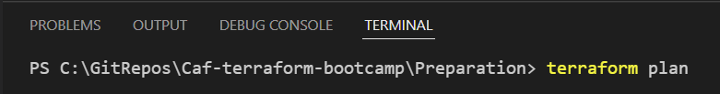
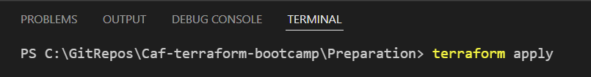
7. Deploy custom landing zone
To deploy a custom landing zone, we will use guide from link bellow
[Examples] Deploy Custom Landing Zone Archetypes · Azure/terraform-azurerm-caf-enterprise-scale Wiki (github.com)
Step 3:
Save files
Plan deployment: execute terraform plan
Execute terraform apply -auto-approve
After deployment verify configuration

Slide 59
Subscription overrides
Reorganize other subscriptions
Add code colored in purple to main.tf
Plan deployment: execute terraform plan
Execute terraform apply -auto-approve
After deployment verify configuration
subscription_id_overrides = {
sandboxes = ["2df3950c-4318-4599-b882-159d42df8779"]
#management = []
#root = []
}

Slide 60
8. Customize deployed custom landing zone
{
"type": "Microsoft.Authorization/policyDefinitions",
"name": "Deny-NIC-NSG",
"properties": {
"displayName": "Deny NSG NIC",
"description": "This policy will prevent NSGs from being applied to network interface cards.",
"policyType": "Custom",
"mode": "All",
"metadata": {
"version": "1.0.0",
"category": "Network"
},
"parameters": {
"effectType": {
"type": "String",
"defaultValue": "deny",
"allowedValues": [
"audit",
"deny",
"disabled"
],
"metadata": {
"displayName": "Effect",
"description": "Enable or disable the execution of the policy"
}
}
},
"policyRule": {
"if": {
"allOf": [
{
"field": "type",
"equals": "Microsoft.Network/networkInterfaces"
},
{
"field": "Microsoft.Network/networkInterfaces/networkSecurityGroup.id",
"like": "*"
}
]
},
"then": {
"effect": "[parameters('effectType')]"
}
}
}
}
Required Steps:
Create a custom policy definition
Create policy assignment file for the custom policy definition
Create an Archetype extension file for ‘es_root’ to save the ‘Deny-NIC-NSG’ custom policy definition at this scope
Modify the ‘eu_customer’ archetype to assign the custom policy definition ‘Deny-NIC-NSG’
Run Terraform Plan and Terraform Apply
Step 1: Create a custom policy definition:
Create a folder named ‘policy_definitions’ in ‘\lib’ folder
Create a file named ‘policy_definition_es_deny_nic_nsg.json’ in ‘policy_definitions’ folder
Add the code marked in Blue into the file
Save the file

Slide 61
8. Customize deployed custom landing zone
{
"name": "Deny-NIC-NSG",
"type": "Microsoft.Authorization/policyAssignments",
"apiVersion": "2019-09-01",
"properties": {
"description": "This policy will prevent NSGs from being applied to network interface cards.",
"displayName": "Deny NSG NIC",
"notScopes": [],
"parameters": {} ,
"policyDefinitionId": "${root_scope_resource_id}/providers/Microsoft.Authorization/policyDefinitions/Deny-NIC-NSG",
"scope": "${current_scope_resource_id}",
"enforcementMode": null,
"nonComplianceMessages": [
{
"message": "NSGs must not be applied to Network Interface cards."
}
]
},
"location": "${default_location}",
"identity": {
"type": "SystemAssigned"
}
}
Required Steps:
Create a custom policy definition
Create policy assignment file for the custom policy definition
Create an Archetype extension file for ‘es_root’ to save the ‘Deny-NIC-NSG’ custom policy definition at this scope
Modify the ‘eu_customer’ archetype to assign the custom policy definition ‘Deny-NIC-NSG’
Run Terraform Plan and Terraform Apply
Step 2: Create a Policy Assignment file:
Create a folder named ‘policy_assignments’ in ‘\lib’ folder
Create a file named ‘policy_assignment_es_deny_nic_nsg.json’ in ‘policy_assignments’ folder
Add the code marked in green into the file
Save the file

Slide 62
8. Customize deployed custom landing zone
Required Steps:
Create a custom policy definition
Create policy assignment file for the custom policy definition
Create an Archetype extension file for ‘es_root’ to save the ‘Deny-NIC-NSG’ custom policy definition at this scope
Modify the ‘eu_customer’ archetype to assign the custom policy definition ‘Deny-NIC-NSG’
Run Terraform Plan and Terraform Apply
{
"extend_es_root": {
"policy_assignments": [],
"policy_definitions": ["Deny-NIC-NSG"],
"policy_set_definitions": [],
"role_definitions": [],
"archetype_config": {
"parameters": {},
"access_control": {}
}
}
}
Step 3: Modify the archetype file
Create a new file named ‘archetype_extension_es_root.tmpl.json’ and copy the code from the right-hand side of the slide into the file
Save the file
The “Deny-NIC-NSG” policy is now available to use but has not yet been assigned anywhere

Slide 63
8. Customize deployed custom landing zone
Required Steps:
Create a custom policy definition
Create policy assignment file for the custom policy definition
Create an Archetype extension file for ‘es_root’ to save the ‘Deny-NIC-NSG’ custom policy definition at this scope
Modify the ‘eu_customer’ archetype to assign the custom policy definition ‘Deny-NIC-NSG’
Run Terraform Plan and Terraform Apply
{
"eu_customer": {
"policy_assignments": ["Deny-Resource-Locations", "Deny-RSG-Locations", "Deny-NIC-NSG"],
"policy_definitions": []
"policy_set_definitions": [],
"role_definitions": [],
"archetype_config": {
"parameters": {
"Deny-Resource-Locations": {
"listOfAllowedLocations": [
"West Europe",
"North Europe"
]
},
"Deny-RSG-Locations": {
"listOfAllowedLocations": [
"West Europe",
"North Europe"
]
}
},
"access_control": {}
}
}
}
Step 4: Create an Archetype extension file for ‘es_root’
Update the ‘archetype_definition_eu_customer.json‘ file with the code marked in Blue
Save the file

Slide 64
8. Customize deployed custom landing zone
Required Steps:
Create a custom policy definition
Create policy assignment file for the custom policy definition
Create an Archetype extension file for ‘es_root’ to save the ‘Deny-NIC-NSG’ custom policy definition at this scope
Modify the ‘eu_customer’ archetype to assign the custom policy definition ‘Deny-NIC-NSG’
Run Terraform Plan and Terraform Apply
Step 5:
Plan deployment: Execute terraform plan
Execute terraform apply -auto-approve
After deployment verify configuration

Slide 65
9. Customize built-in archetypes
Required Steps:
Create an Archetype extension file for the Landing Zones Archetype and assign a custom Policy at the Landing Zones Management Group
Create a custom Policy Set definition file named ‘Org-Baseline’
Create an assignment file for the above Policy Set
Update the Archetype extension file for the ‘es_root’ Archetype to assign the custom Policy Set at the ‘es_root’ MG
Run Terraform Plan and Terraform Apply
{
"extend_es_landing_zones": {
"policy_assignments": ["Deny-NIC-NSG"],
"policy_definitions": [],
"policy_set_definitions": [],
"role_definitions": [],
"archetype_config": {
"parameters": {
},
"access_control": {
}
}
}
}
Step 1:
Create a new file named ‘archetype_extension_es_landing_zones.tmpl.json’ and copy the code from the right-hand side of the slide into the file
Save the file

Slide 66
9. Customize a built-in archetype
{
"name": "Org-Baseline",
"type": "Microsoft.Authorization/policySetDefinitions",
"apiVersion": "2021-06-01",
"scope": null,
"properties": {
"policyType": "Custom",
"displayName": "Org Baseline",
"description": "Contains the core policies applicable to the org that need to be assigned at the Root Management Group",
"metadata": {
"version": "1.0.0",
"category": "General"
},
"parameters": {
"Azure Cosmos DB accounts should have firewall rules - Effect Type": {
"type": "String",
"defaultValue": "Audit",
"allowedValues": [
"Audit",
"Deny",
"Disabled"
],
"metadata": {
"displayName": "Azure Cosmos DB accounts should have firewall rules",
"description": "Firewall rules should be defined on your Azure Cosmos DB accounts to prevent traffic from unauthorized sources. Accounts that have at least one IP rule defined with the virtual network filter enabled are deemed compliant. Accounts disabling public access are also deemed compliant."
}
},
"Deny NSG NIC - Effect Type": {
"type": "String",
"defaultValue": “deny",
"allowedValues": [
“audit",
“deny",
“disabled"
],
"metadata": {
"displayName": "Enable or disable the execution of the policy",
"description": "This policy will prevent NSGs from being applied to network interface cards."
}
}
},
"policyDefinitions": [
{
"policyDefinitionReferenceId": "Audit VMs that do not use managed disks",
"policyDefinitionId": "/providers/Microsoft.Authorization/policyDefinitions/06a78e20-9358-41c9-923c-fb736d382a4d",
"groupNames": []
},
{
"policyDefinitionReferenceId": "Azure Cosmos DB accounts should have firewall rules",
"policyDefinitionId": "/providers/Microsoft.Authorization/policyDefinitions/862e97cf-49fc-4a5c-9de4-40d4e2e7c8eb",
"parameters": {
"effect": {
"value": "[parameters('Azure Cosmos DB accounts should have firewall rules - Effect Type')]"
}
},
"groupNames": []
},
{
"policyDefinitionReferenceId": "Deny NSG NIC",
"policyDefinitionId": "${root_scope_resource_id}/providers/Microsoft.Authorization/policyDefinitions/Deny-NIC-NSG",
"parameters": {
"effectType": {
"value": "[parameters('Deny NSG NIC - Effect Type')]"
}
},
"groupNames": []
}
],
"policyDefinitionGroups": null
}
}
Required Steps:
Create an Archetype extension file for the Landing Zones Archetype and assign a custom Policy at the Landing Zones Management Group
Create a custom Policy Set definition file named ‘Org-Baseline’
Create an assignment file for the above Policy Set
Update the Archetype extension file for the ‘es_root’ Archetype to assign the custom Policy Set at the ‘es_root’ MG
Run Terraform Plan and Terraform Apply
Step 2:
In your ‘/lib’ folder, create a subfolder named ‘policy_set_definitions’
Create a file named ‘policy_set_definition_es_org_baseline.tmpl.json’
Copy the code on the right-hand side of the slide into the file
Save the file

Slide 67
9. Customize a built-in archetype
{
"name": "Org-Baseline",
"type": "Microsoft.Authorization/policyAssignments",
"apiVersion": "2019-09-01",
"properties": {
"description": "Contains the core policies applicable to the org that need to be assigned at the Root MG",
"displayName": "Org Baseline",
"notScopes": [],
"parameters": {
},
"policyDefinitionId": "${root_scope_resource_id}/providers/Microsoft.Authorization/policySetDefinitions/Org-Baseline",
"scope": "${current_scope_resource_id}",
"enforcementMode": null
},
"location": "${default_location}",
"identity": {
"type": "SystemAssigned"
}
}
Required Steps:
Create an Archetype extension file for the Landing Zones Archetype and assign a custom Policy at the Landing Zones Management Group
Create a custom Policy Set definition file named ‘Org-Baseline’
Create an assignment file for the above Policy Set
Update the Archetype extension file for the ‘es_root’ Archetype to assign the custom Policy Set at the ‘es_root’ MG
Run Terraform Plan and Terraform Apply
Step 3:
In your ‘/lib/Policy_Assignments’ folder, create a file named ‘policy_assignment_es_org_baseline.json’
Copy the code on the right-hand side of the slide into the file
Save the file

Slide 68
9. Customize a built-in archetype
{
"extend_es_root": {
"policy_assignments": ["Org-Baseline"],
"policy_definitions": ["Deny-NIC-NSG"],
"policy_set_definitions": ["Org-Baseline"],
"role_definitions": [],
"archetype_config": {
"parameters": {},
"access_control": {}
}
}
}
Required Steps:
Create an Archetype extension file for the Landing Zones Archetype and assign a custom Policy at the Landing Zones Management Group
Create a custom Policy Set definition file named ‘Org-Baseline’
Create an assignment file for the above Policy Set
Update the Archetype extension file for the ‘es_root’ Archetype to assign the custom Policy Set at the ‘es_root’ MG
Run Terraform Plan and Terraform Apply
Step 4:
Update the ‘archetype_extension_es_root.tmpl.json’ file with the code from the right-hand side of the slide
Save the file

Slide 69
9. Customize a built-in archetype
Required Steps:
Create an Archetype extension file for the Landing Zones Archetype and assign a custom Policy at the Landing Zones Management Group
Create a custom Policy Set definition file named ‘Org-Baseline’
Create an assignment file for the above Policy Set
Update the Archetype extension file for the ‘es_root’ Archetype to assign the custom Policy Set at the ‘es_root’ MG
Run Terraform Plan and Terraform Apply
Step 5:
Plan deployment: Execute terraform plan
Execute terraform apply -auto-approve
After deployment verify configuration

Slide 70
10. Create & Assign Custom RBAC roles
{
"name": "dc726155-3983-5405-b446-9bb27b94e02c",
"type": "Microsoft.Authorization/roleDefinitions",
"apiVersion": "2018-01-01-preview",
"properties": {
"roleName": "Network-Management",
"description": "Platform-wide global connectivity management: virtual networks, UDRs, NSGs, NVAs, VPN, Azure ExpressRoute, and others",
"type": "customRole",
"permissions": [
{
"actions": [
"*/read",
"Microsoft.Network/*",
"Microsoft.Resources/deployments/*",
"Microsoft.Support/*"
],
"notActions": [],
"dataActions": [],
"notDataActions": []
}
],
"assignableScopes": [
"${current_scope_resource_id}"
]
}
}
Required Steps:
Create a custom Role Definition file for an example role named ‘Network Management’
Verify the Unique ‘name’ property value for the role by using the UUIDv5 function
Save the custom ‘Network Management’ role at the ‘es_root’ Management Group and assign the custom RBAC role to a group from your tenant
Run Terraform Plan and Terraform Apply
Step 1:
In your ‘/lib’ folder, create a subfolder named ‘role_definitions’
In your ‘/lib/ role_definitions’ folder, create a file named ‘role_definition_es_network_management.tmpl.json’
Copy the code from the right-hand side into the file
Save the file

Slide 71
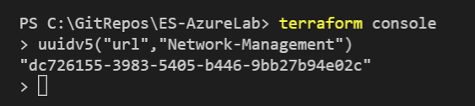
10. Create & Assign Custom RBAC roles
Required Steps:
Create a custom Role Definition file for an example role named ‘Network Management’
Verify the Unique ‘name’ property value for the role by using the UUIDv5 function
Save the custom ‘Network Management’ role at the ‘es_root’ Management Group and assign the custom RBAC role to a group from your tenant
Run Terraform Plan and Terraform Apply
Step 2:
From your terminal, type ‘terraform console’
When the console loads, type ‘uuidv5("url","Network-Management")’
The return value should equal “dc726155-3983-5405-b446-9bb27b94e02c”
Note: The UUIDv5 function can be used to generate unique names for other custom roles

Slide 72
10. Create & Assign Custom RBAC roles
{
"extend_es_root": {
"policy_assignments": ["Org-Baseline"],
"policy_definitions": ["Deny-NIC-NSG"],
"policy_set_definitions": ["Org-Baseline"],
"role_definitions": ["Network-Management"],
"archetype_config": {
"parameters": {},
"access_control": {
"[CONTOSO] Network-Management":[
"db5b8de4-80d5-4618-b1b6-854948785609"
]
}
}
}
}
Required Steps:
Create a custom Role Definition file for an example role named ‘Network Management’
Verify the Unique ‘name’ property value for the role by using the UUIDv5 function
Save the custom ‘Network Management’ role at the ‘es_root’ Management Group and assign the custom RBAC role to a group from your tenant
Run Terraform Plan and Terraform Apply
Step 3:
Update the ‘archetype_extension_es_root.tmpl.json’ file with the code from the right-hand side of the slide to save and assign the custom RBAC role to a group from your tenant
Save the file

Slide 73
10. Create & Assign Custom RBAC roles
Required Steps:
Create a custom Role Definition file for an example role named ‘Network Management’
Verify the Unique ‘name’ property value for the role by using the UUIDv5 function
Save the custom ‘Network Management’ role at the ‘es_root’ Management Group and assign the custom RBAC role to a group from your tenant
Run Terraform Plan and Terraform Apply
Step 4:
Plan deployment: Execute terraform plan
Execute terraform apply -auto-approve
After deployment verify configuration

Slide 74
Resources
CAF ALZ Terraform Module
Microsoft Docs
Terraform
GitHub
Terraform
LinkedIn Learning – Learn Terraform & Advance Terraform
Plural Sight - Terraform - Getting Started & Terraform Deep Dive
Microsoft Learn - Manage IaC using Azure, DSC, and third-party tools & Implement Terraform
Terraform On Azure
Microsoft Docs
Plural Sight - Implementing Terraform on Microsoft Azure
O’Reilly - Deep-Dive Terraform on Azure

Slide 75
Contributing
Help us improve the module
Raising an Issue
Feature Requests
Contributing to Code
Contributing to Documentation

Slide 76

Thank You

